Slide 1

eMOP Post-OCR Triage
Matthew Christy,
Loretta Auvil,
Dr. Ricardo Gutierrez-Osuna,
Boris Capitanu,
Anshul Gupta,
Elizabeth Grumbach
Diagnosing Page Image Problems with Post-OCR Triage for eMOP

Slide 2
eMOP Info
eMOP Website
More eMOP
emop.tamu.edu/
DH2014 Presentation
emop.tamu.edu/post-processing
eMOP Workflows
emop.tamu.edu/workflows
Mellon Grant Proposal
idhmc.tamu.edu/projects/Mellon/eMOPPublic.pdf
Facebook
The Early Modern OCR Project
Twitter
#emop
@IDHMC_Nexus
@matt_christy
@EMGrumbach
Notes:
The Early Modern OCR Project (eMOP) is an Andrew W. Mellon Foundation funded grant project running out of the Initiative for Digital Humanities, Media, and Culture (IDHMC) at Texas A&M University, to develop and test tools and techniques to apply Optical Character Recognition (OCR) to early modern English documents from the hand press period, roughly 1475-1800. The basic premise of eMOP is to use typeface and book history techniques to train modern OCR engines specifically on the typefaces in our collection of documents, and thereby improve the accuracy of the OCR results. eMOP’s immediate goal is to make machine readable, or improve the readability, for 45 million pages of text from two major proprietary databases: Eighteenth Century Collections Online (ECCO) and Early English Books Online (EEBO). Generally, eMOP aims to improve the visibility of early modern texts by making their contents fully searchable. The current paradigm of searching special collections for early modern materials by either metadata alone or “dirty” OCR is inefficient for scholarly research.

Slide 3
The Numbers
Page Images
Ground Truth
Early English Books online (Proquest) EEBO: ~125,000 documents, ~13 million pages images (1475-1700)
Eighteenth Century Collections Online (Gale Cengage) ECCO: ~182,000 documents, ~32 million page images (1700-1800)
Total: >300,000 documents & 45 million page images.
Text Creation Partnership TCP: ~46,000 double-keyed hand transcribed docuemnts
44,000 EEBO
2,200 ECCO

Slide 4
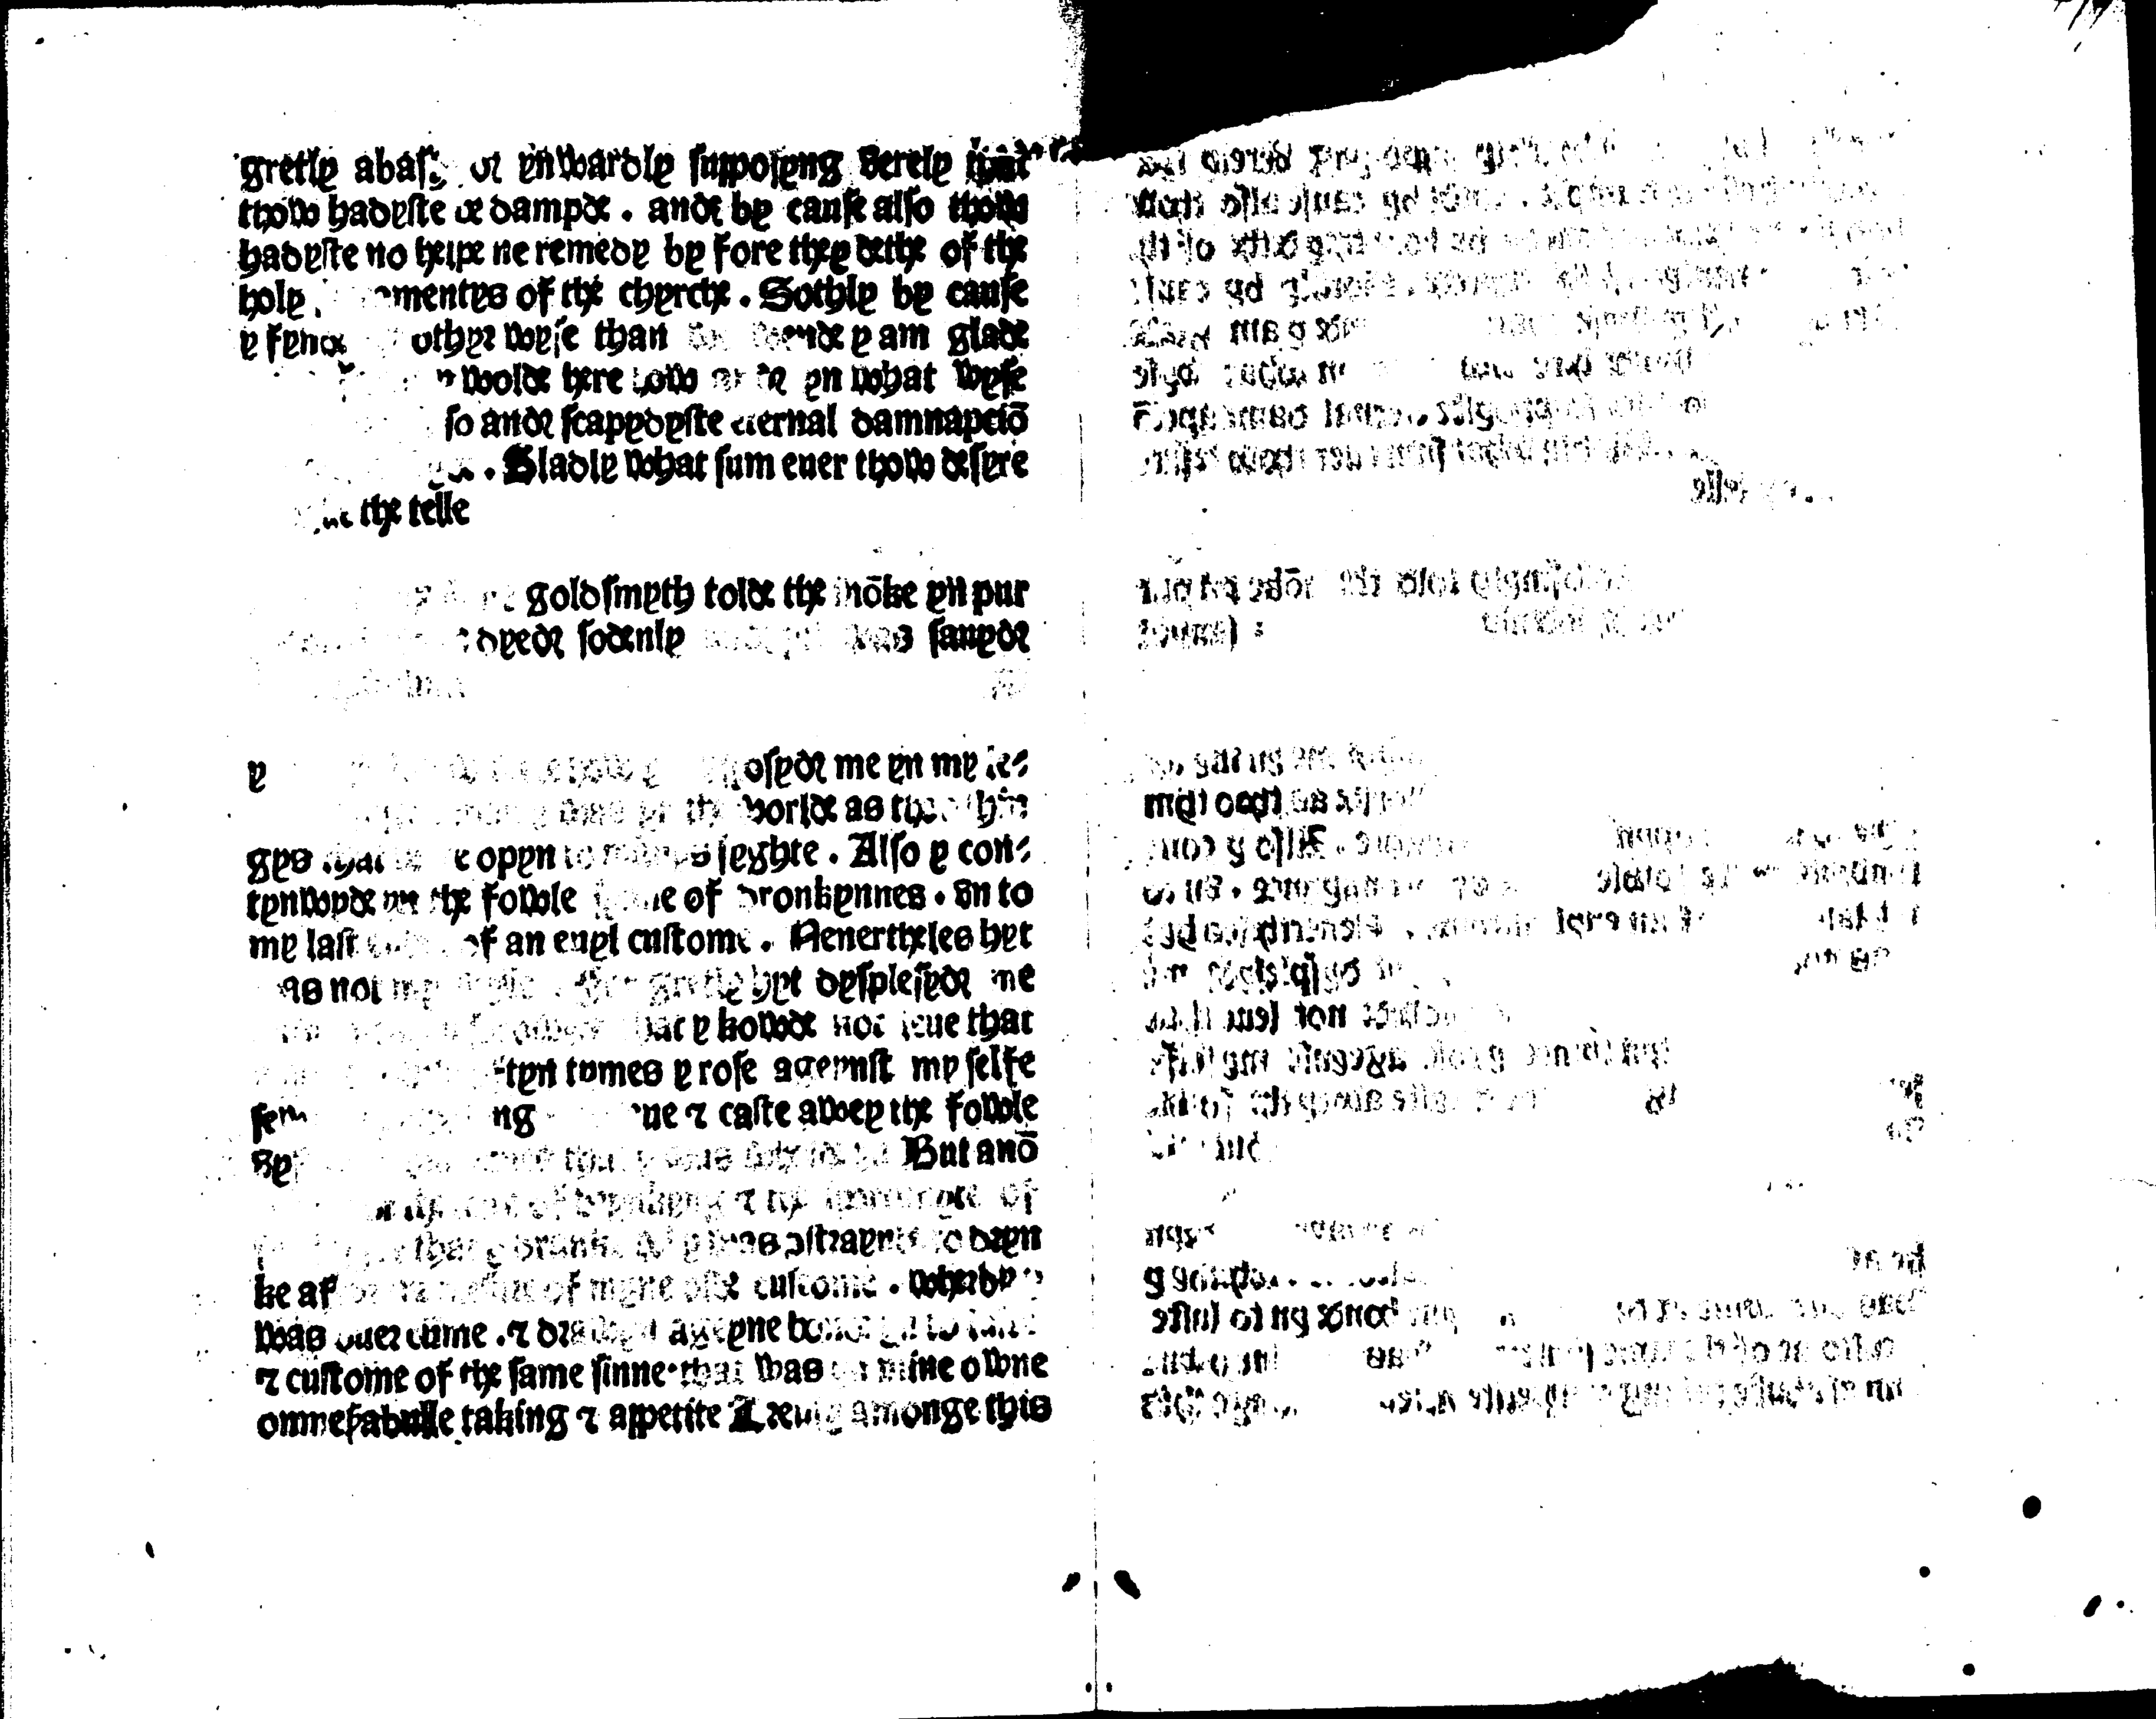
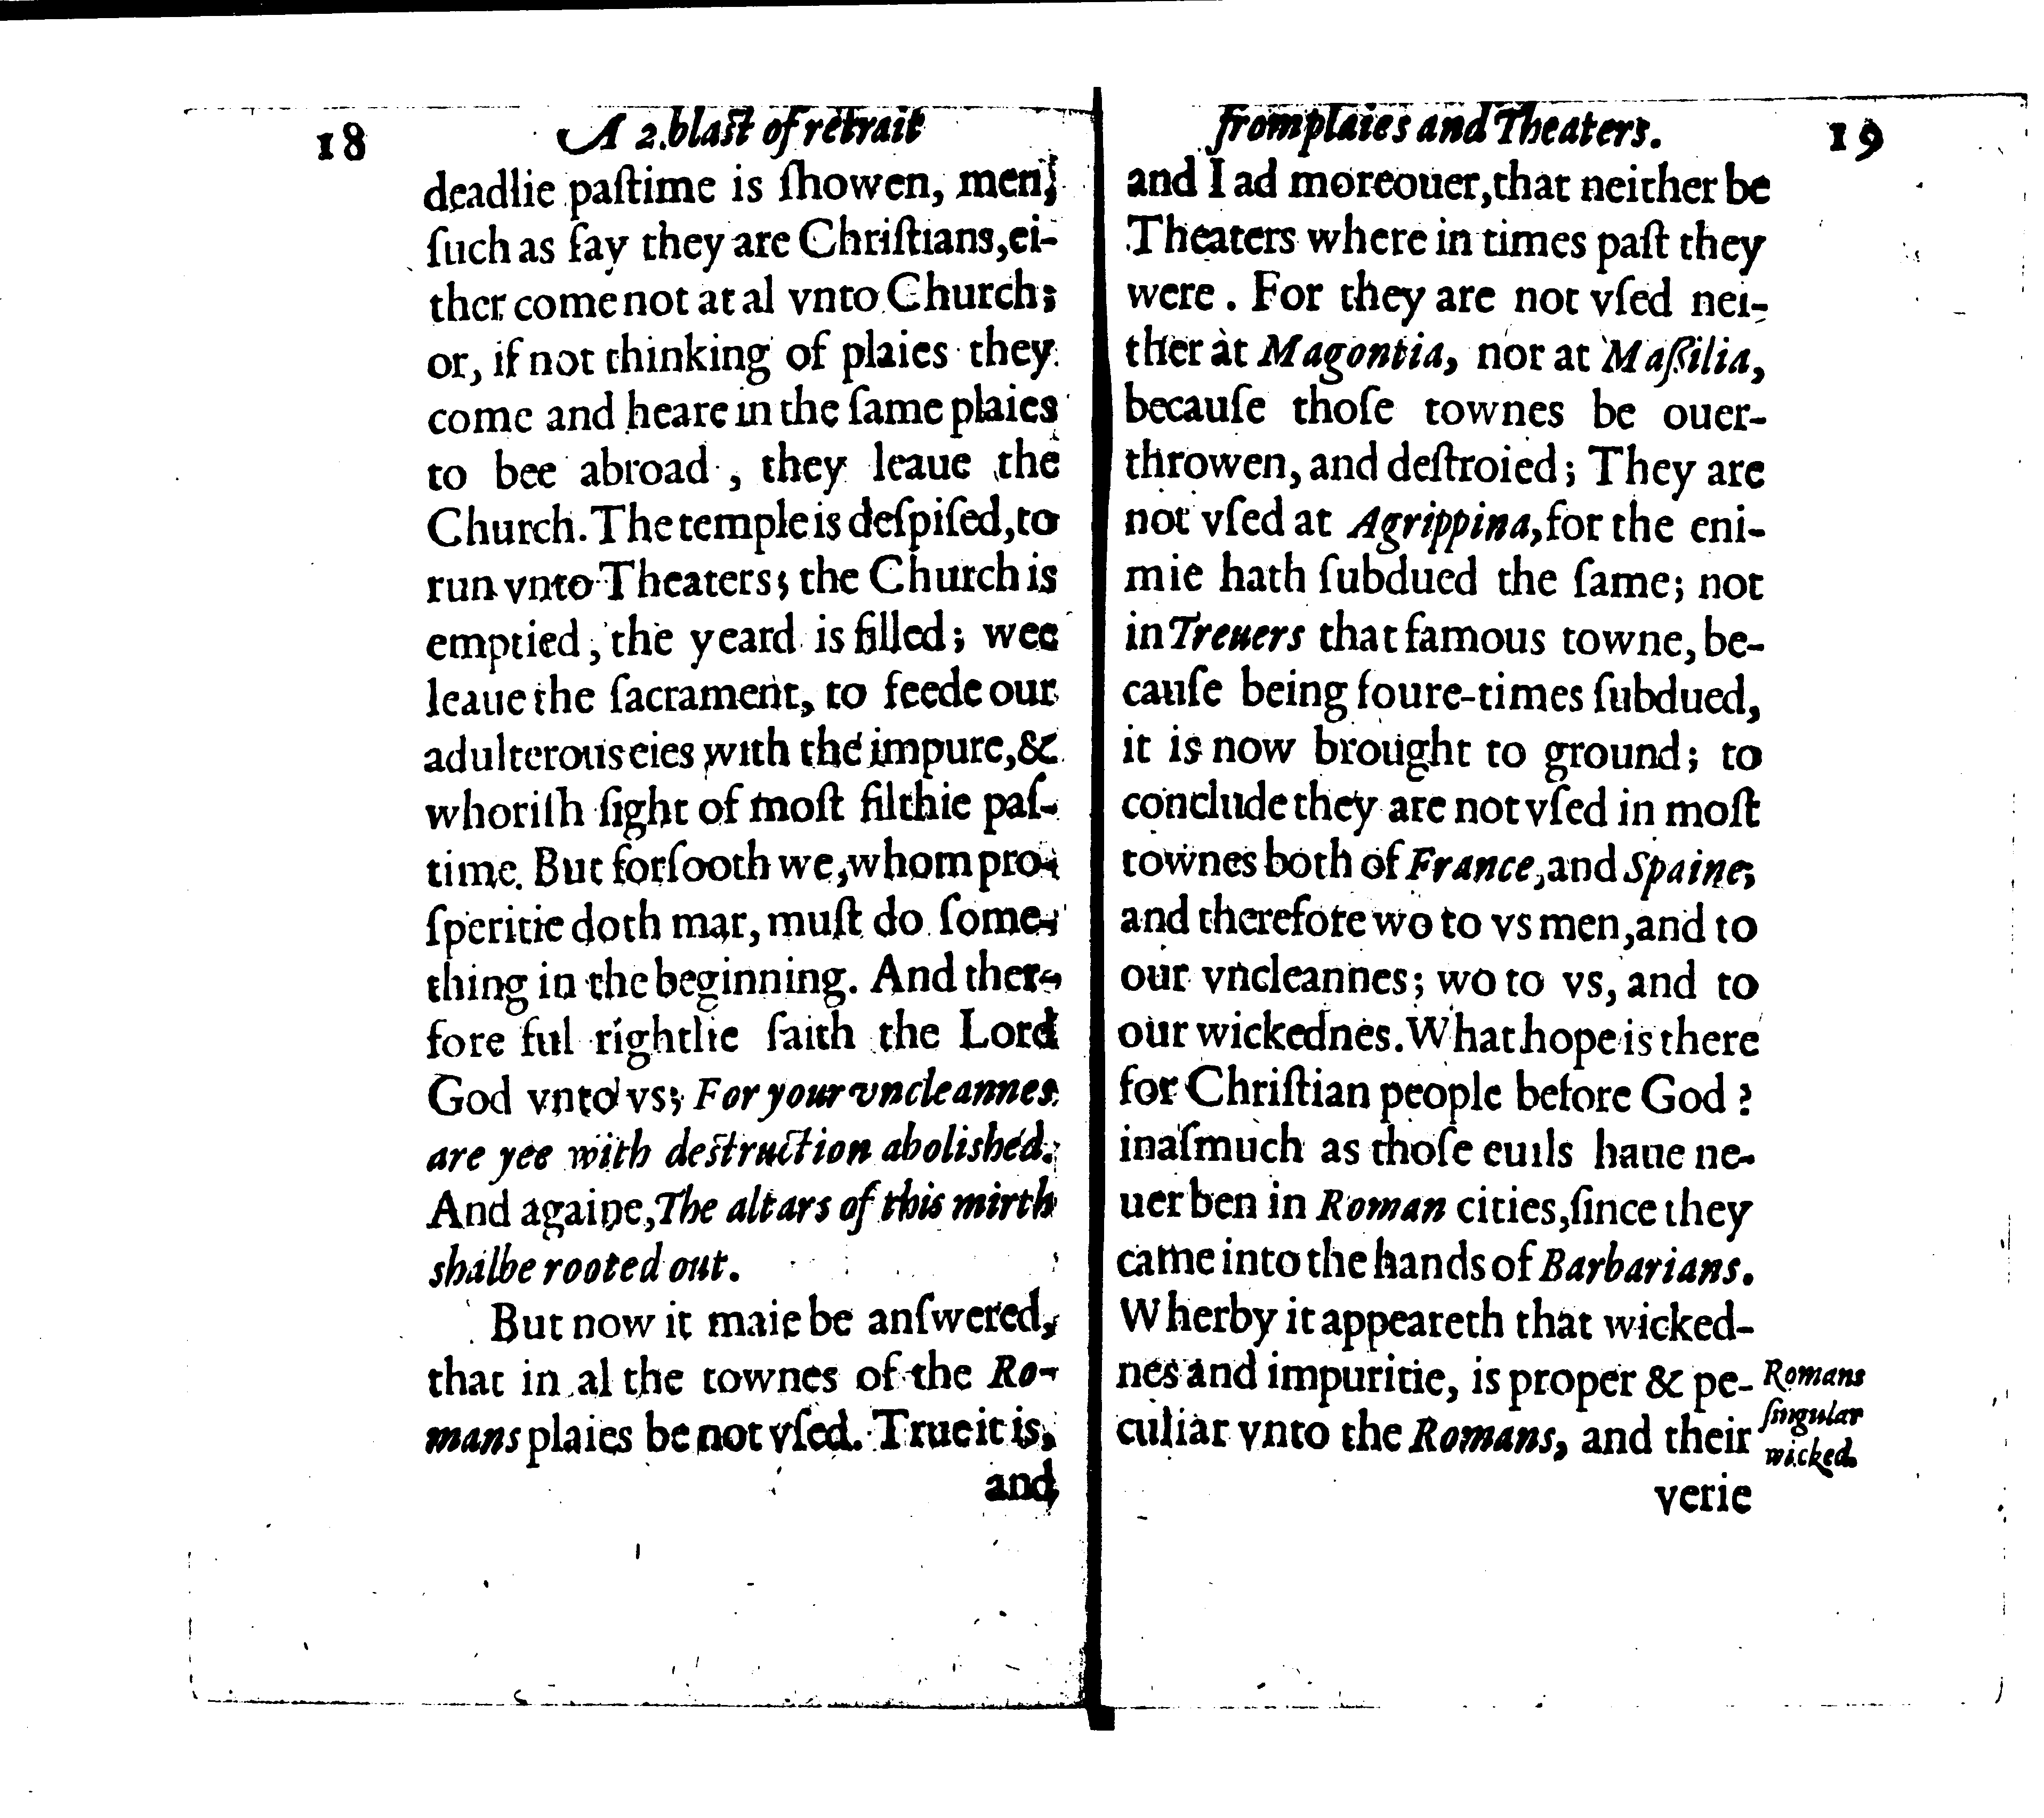
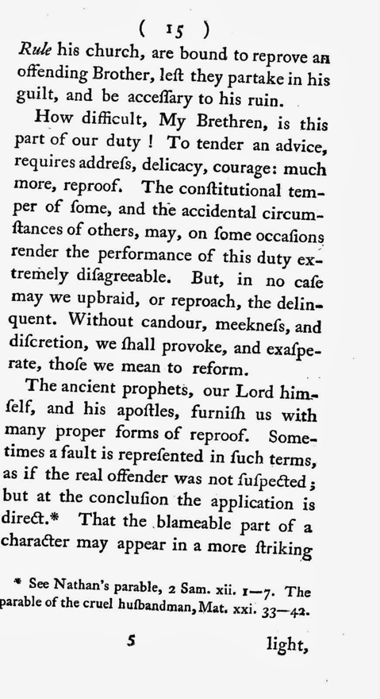
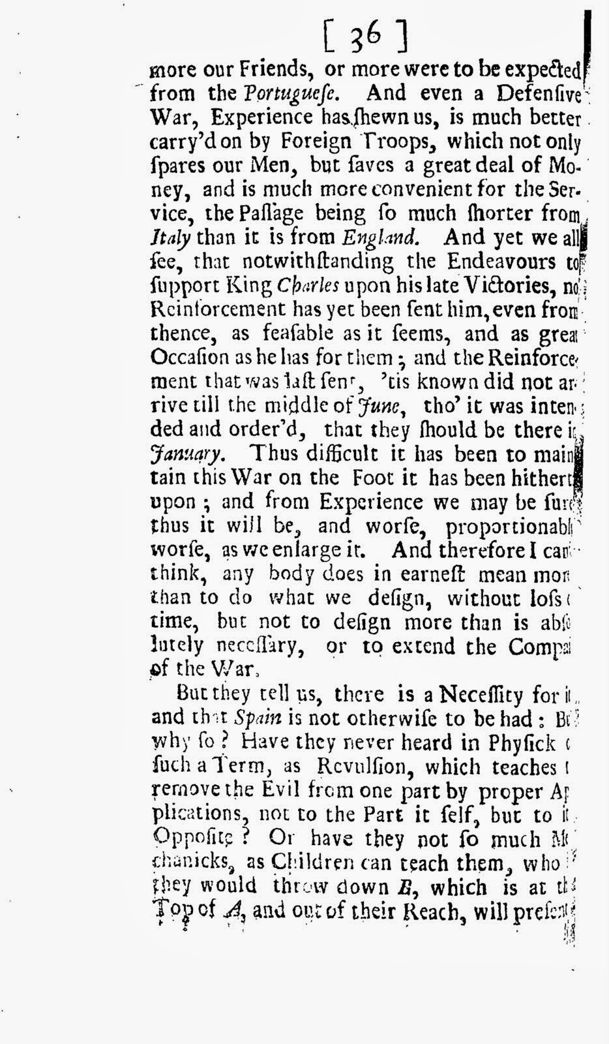
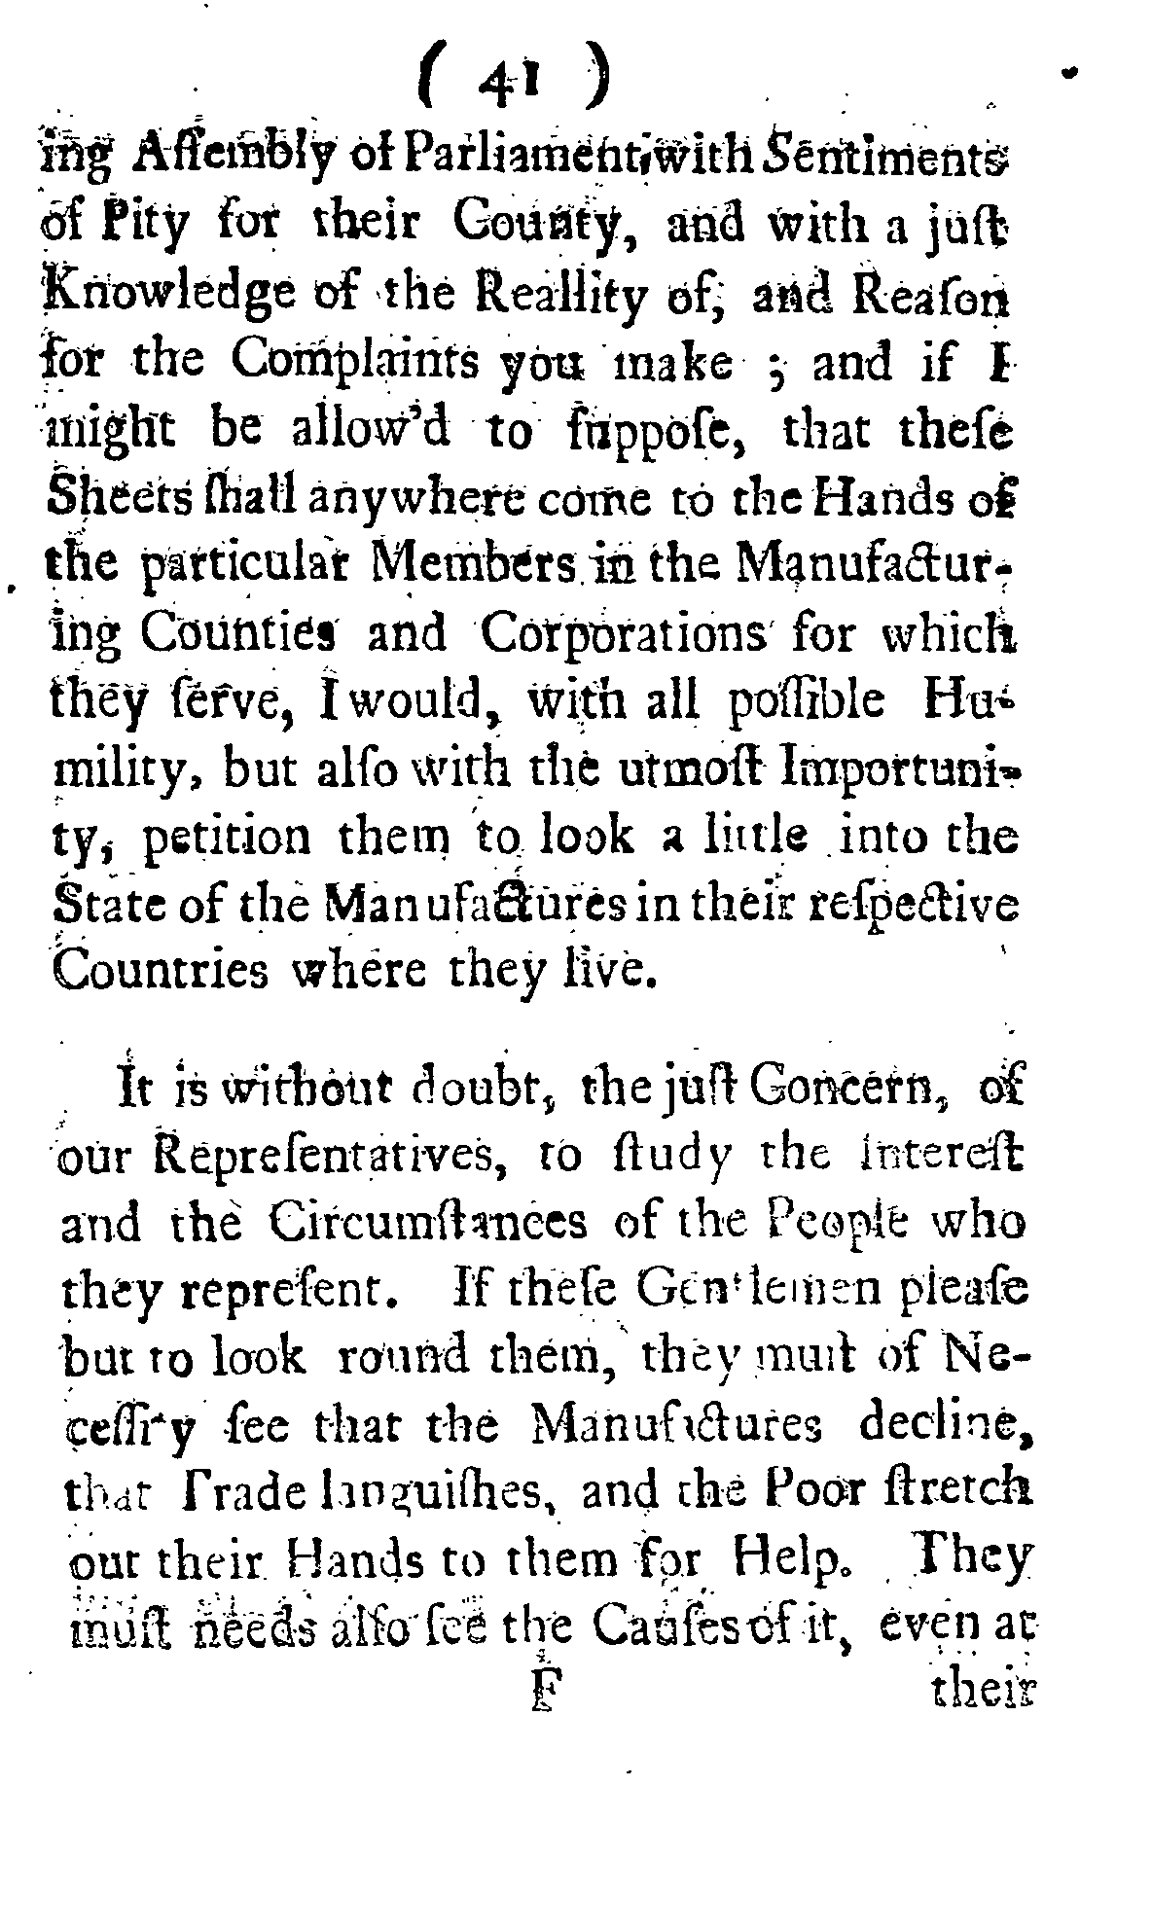
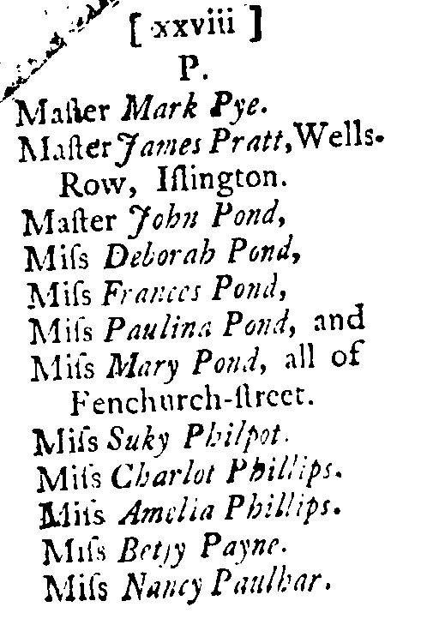
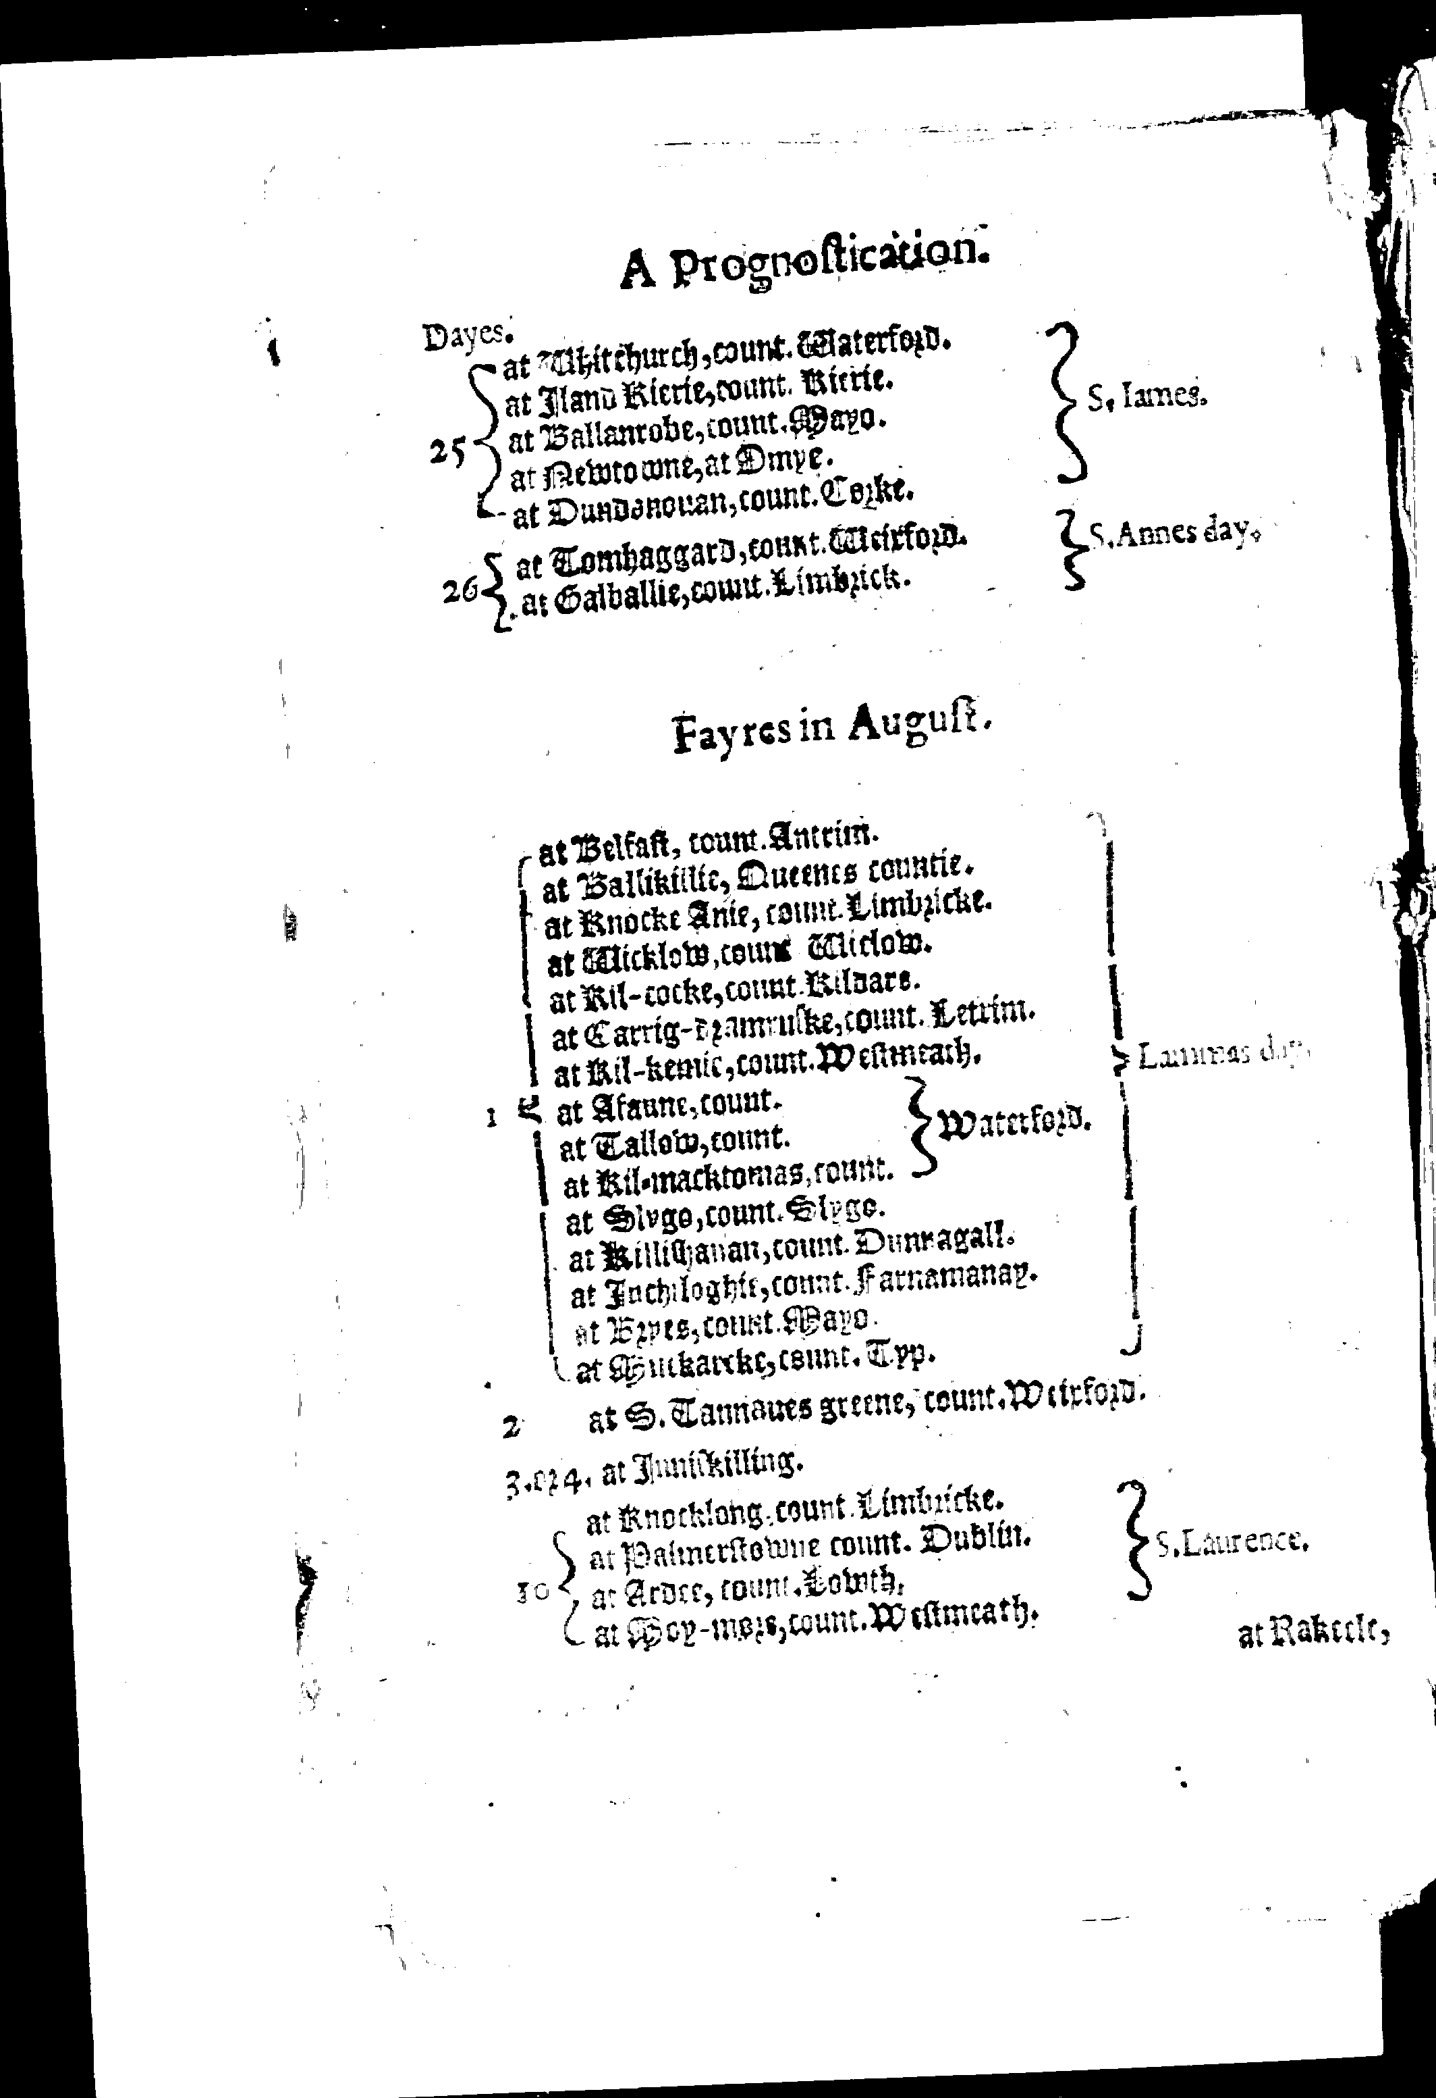
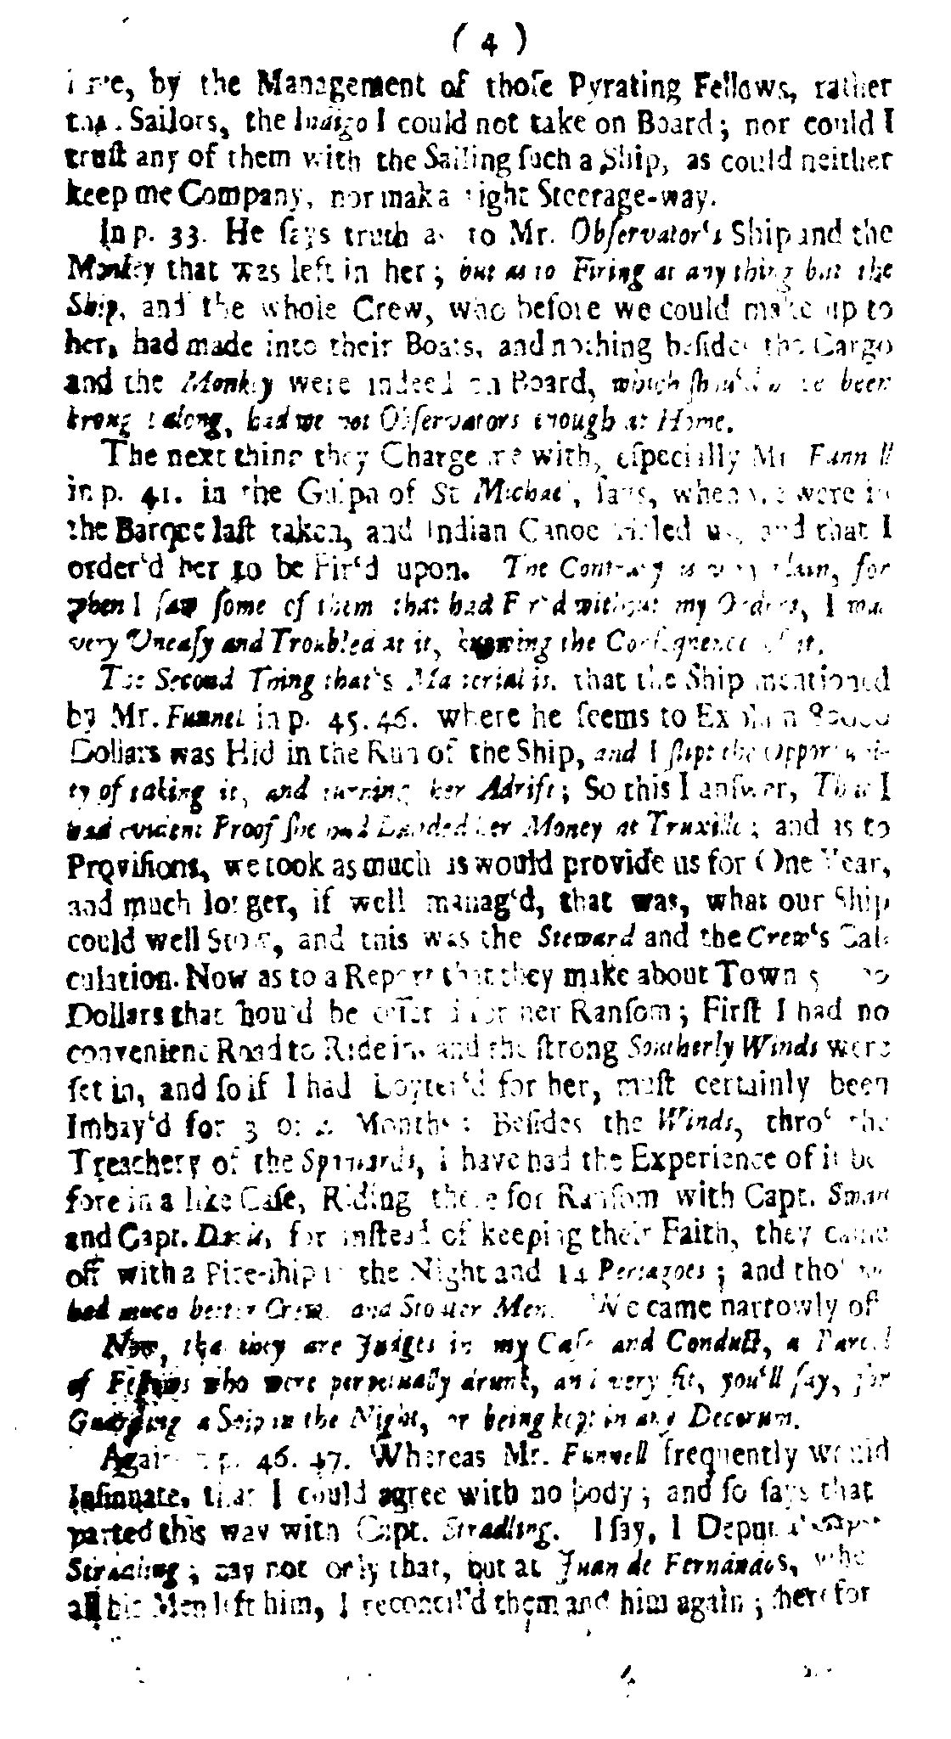
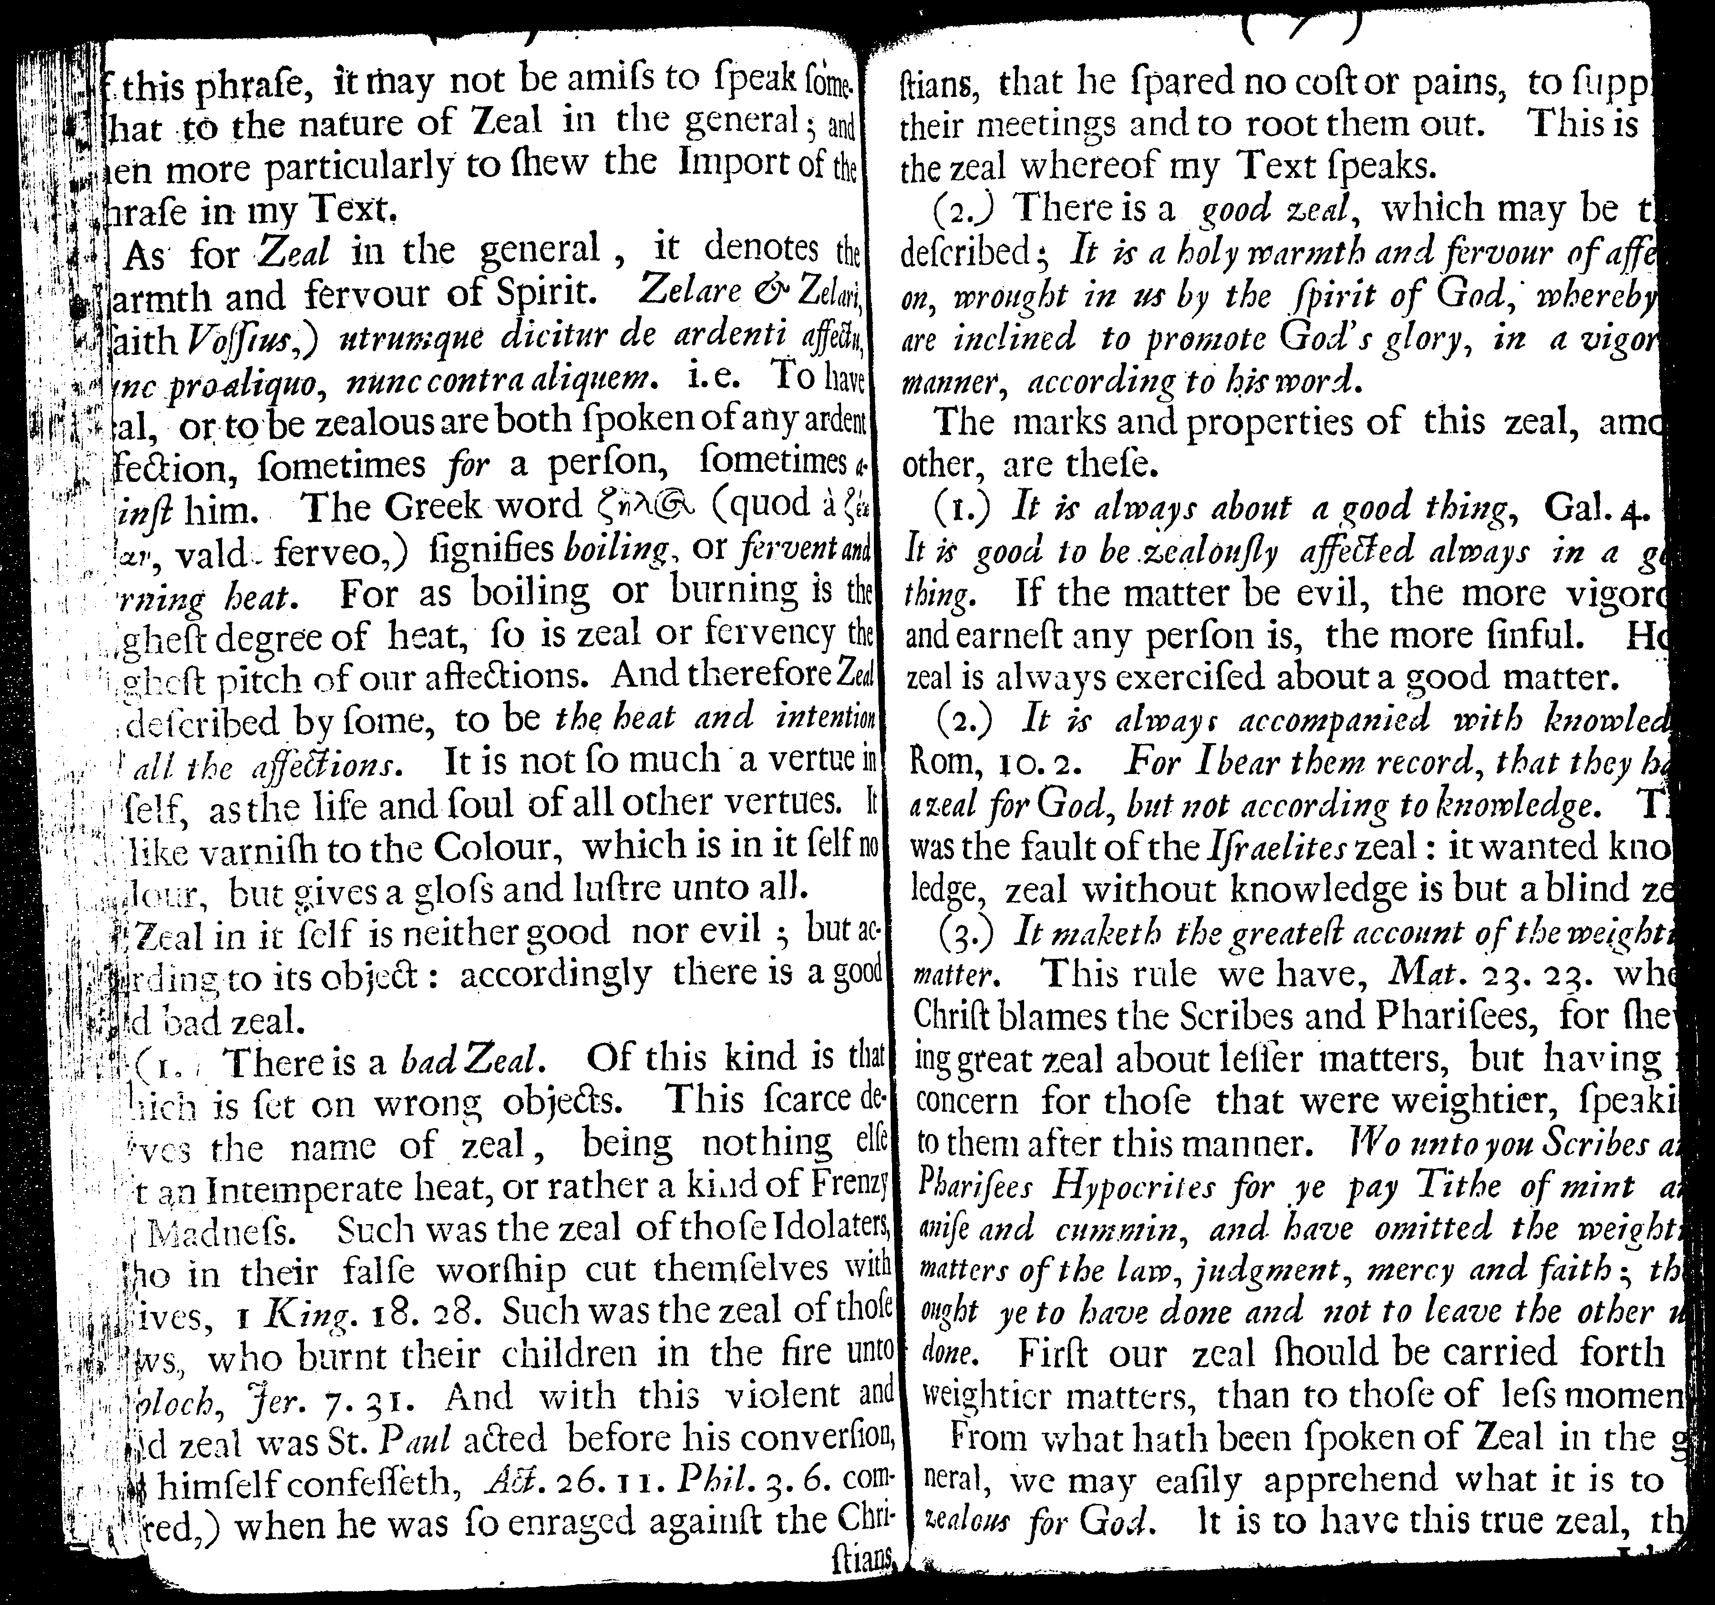
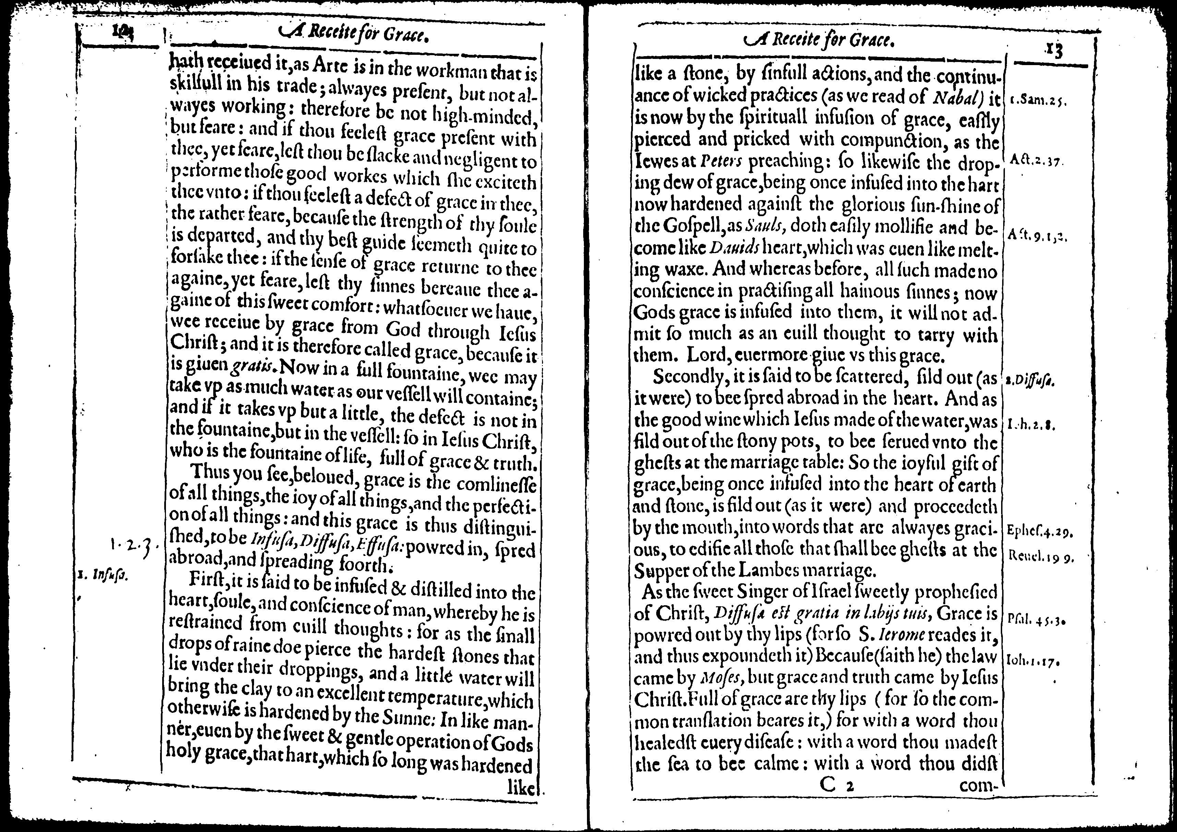
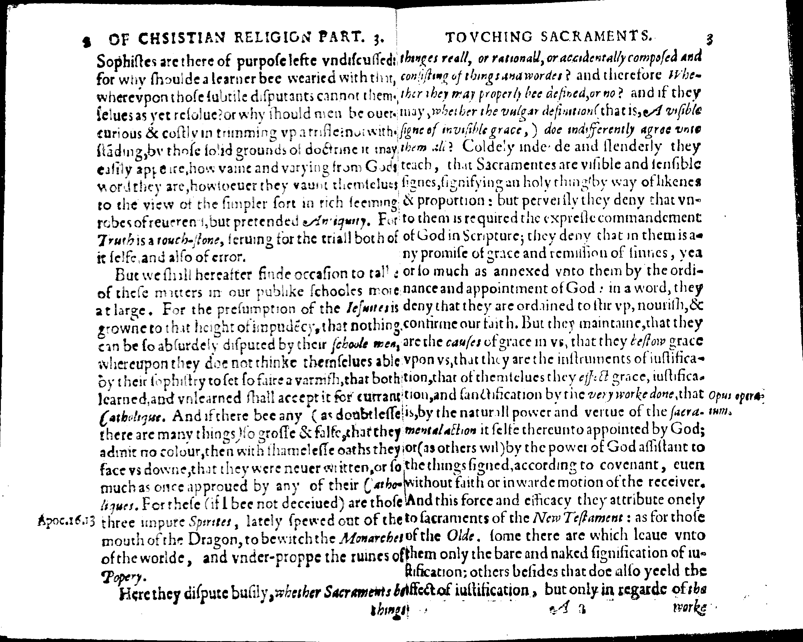
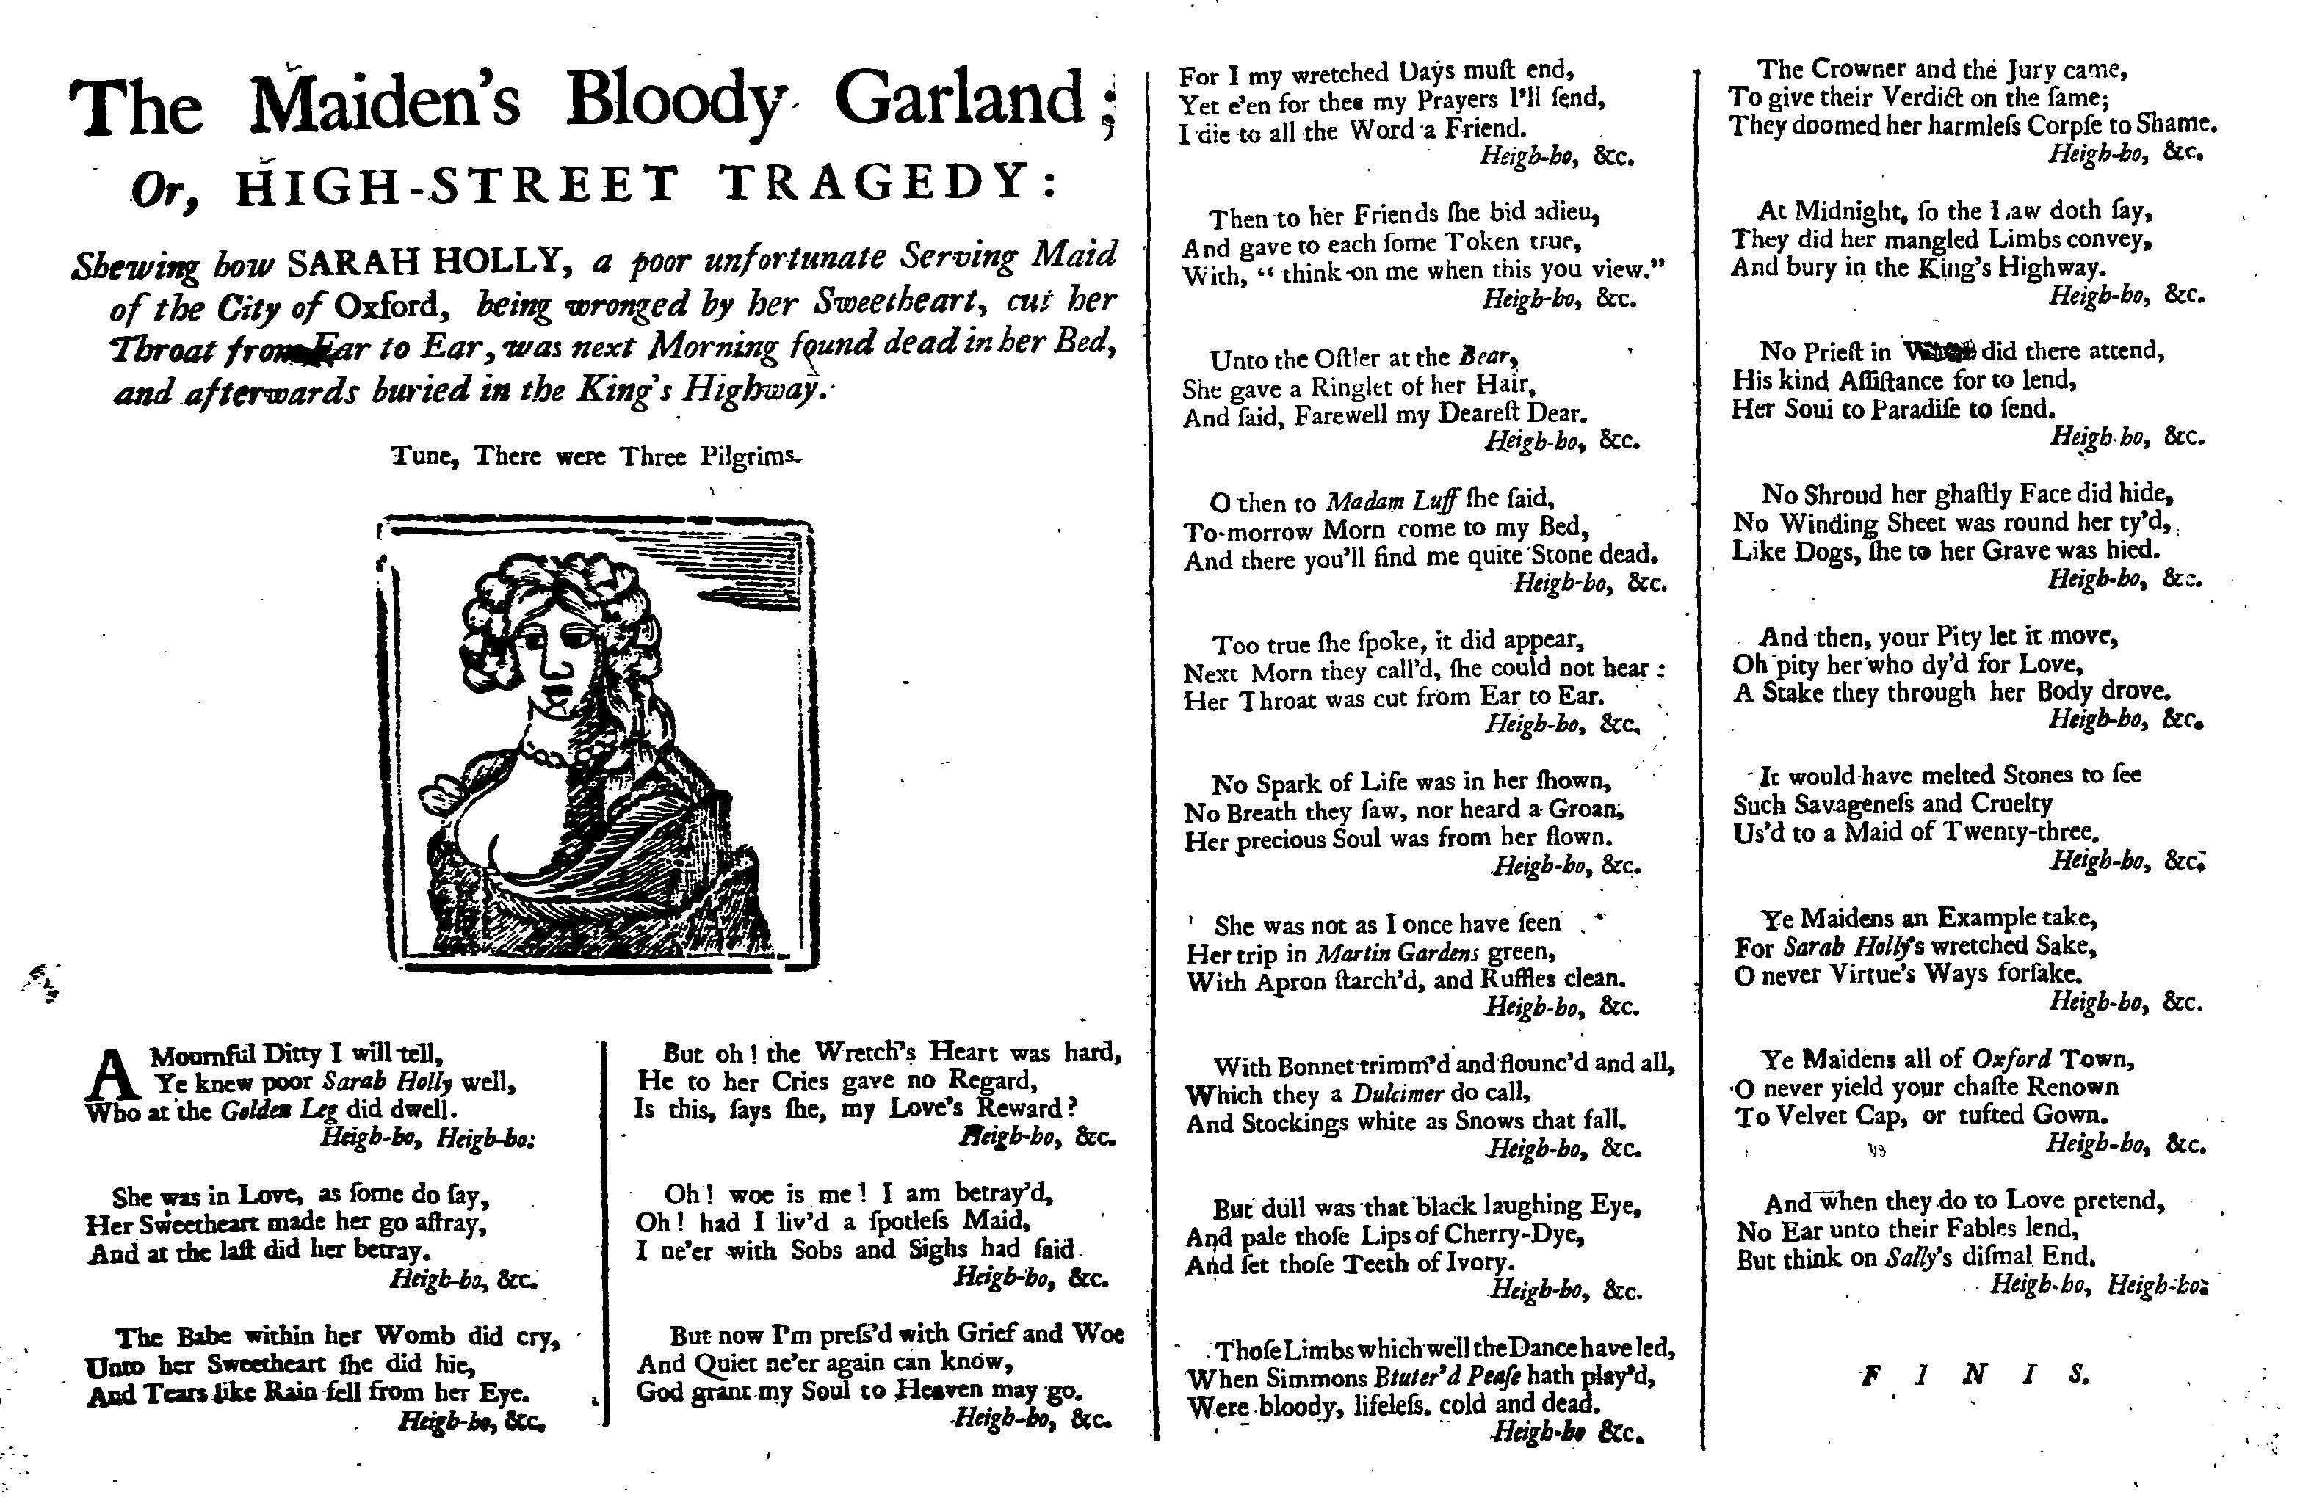
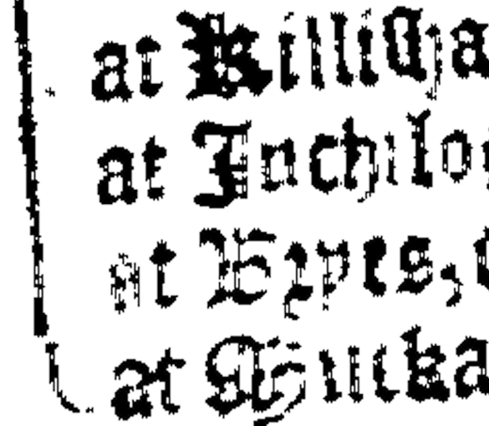
Page Images
Notes:
Some were great
most were not
Noisy
Skewed
Warped
Or they posed challenges for OCR engines
Multiple pages per image
Multiple columns
Images & decorative elements
Marginalia
Missing margins
many were terrible

Slide 5
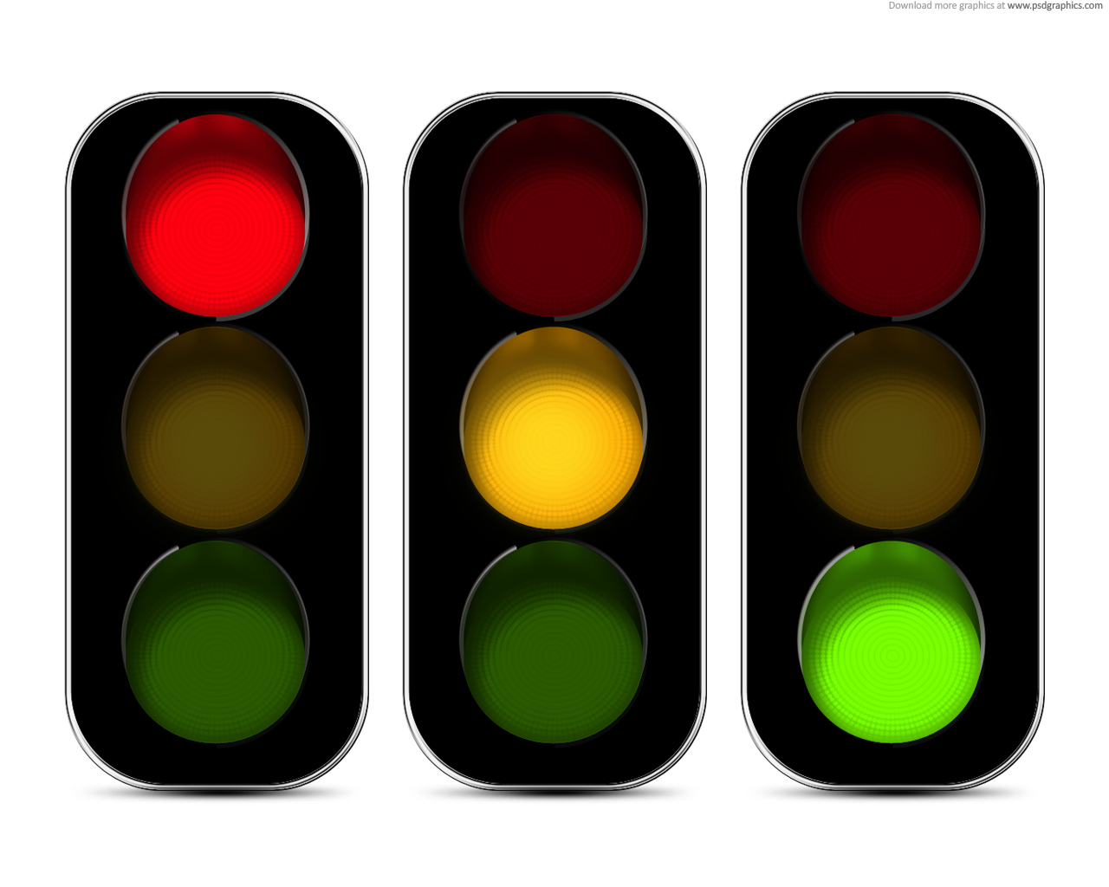
The Constraints
Solution
45 million page images!
Only 2 years
Small IDHMC team focused on gather data and training Tesseract for early modern typefaces
Great team of collaborators focusing on post-processing
Software Environment for the Advancement of Scholarly Research (SEASR) – University of Illinois, Urbana-Champaign
Perception, Sensing, and Instrumentation (PSI) Lab, Texas A&M University
Everything must be open-source
Focus our efforts on post-processing triage and recovery
Triage system will score page results and route pages to be corrected or analyzed for problems
Results:
Good quality, corrected OCR output
A DB of tagged pages indicating pre-processing needs
Notes:
CONSTRAINTS:
We knew there were plenty of pre-processing algorithms to solve many of these problems, but given these constraints we felt we couldn’t conceivably pre-process all pages with all algorithms.
SOLUTION:
By making our triage system more robust we could attempt to correct as much as possible, but also identify page image problems and tag each page in the DB so that we’d know what pre-processing should be applied in order to get better results when re-OCRing again later.

Slide 6
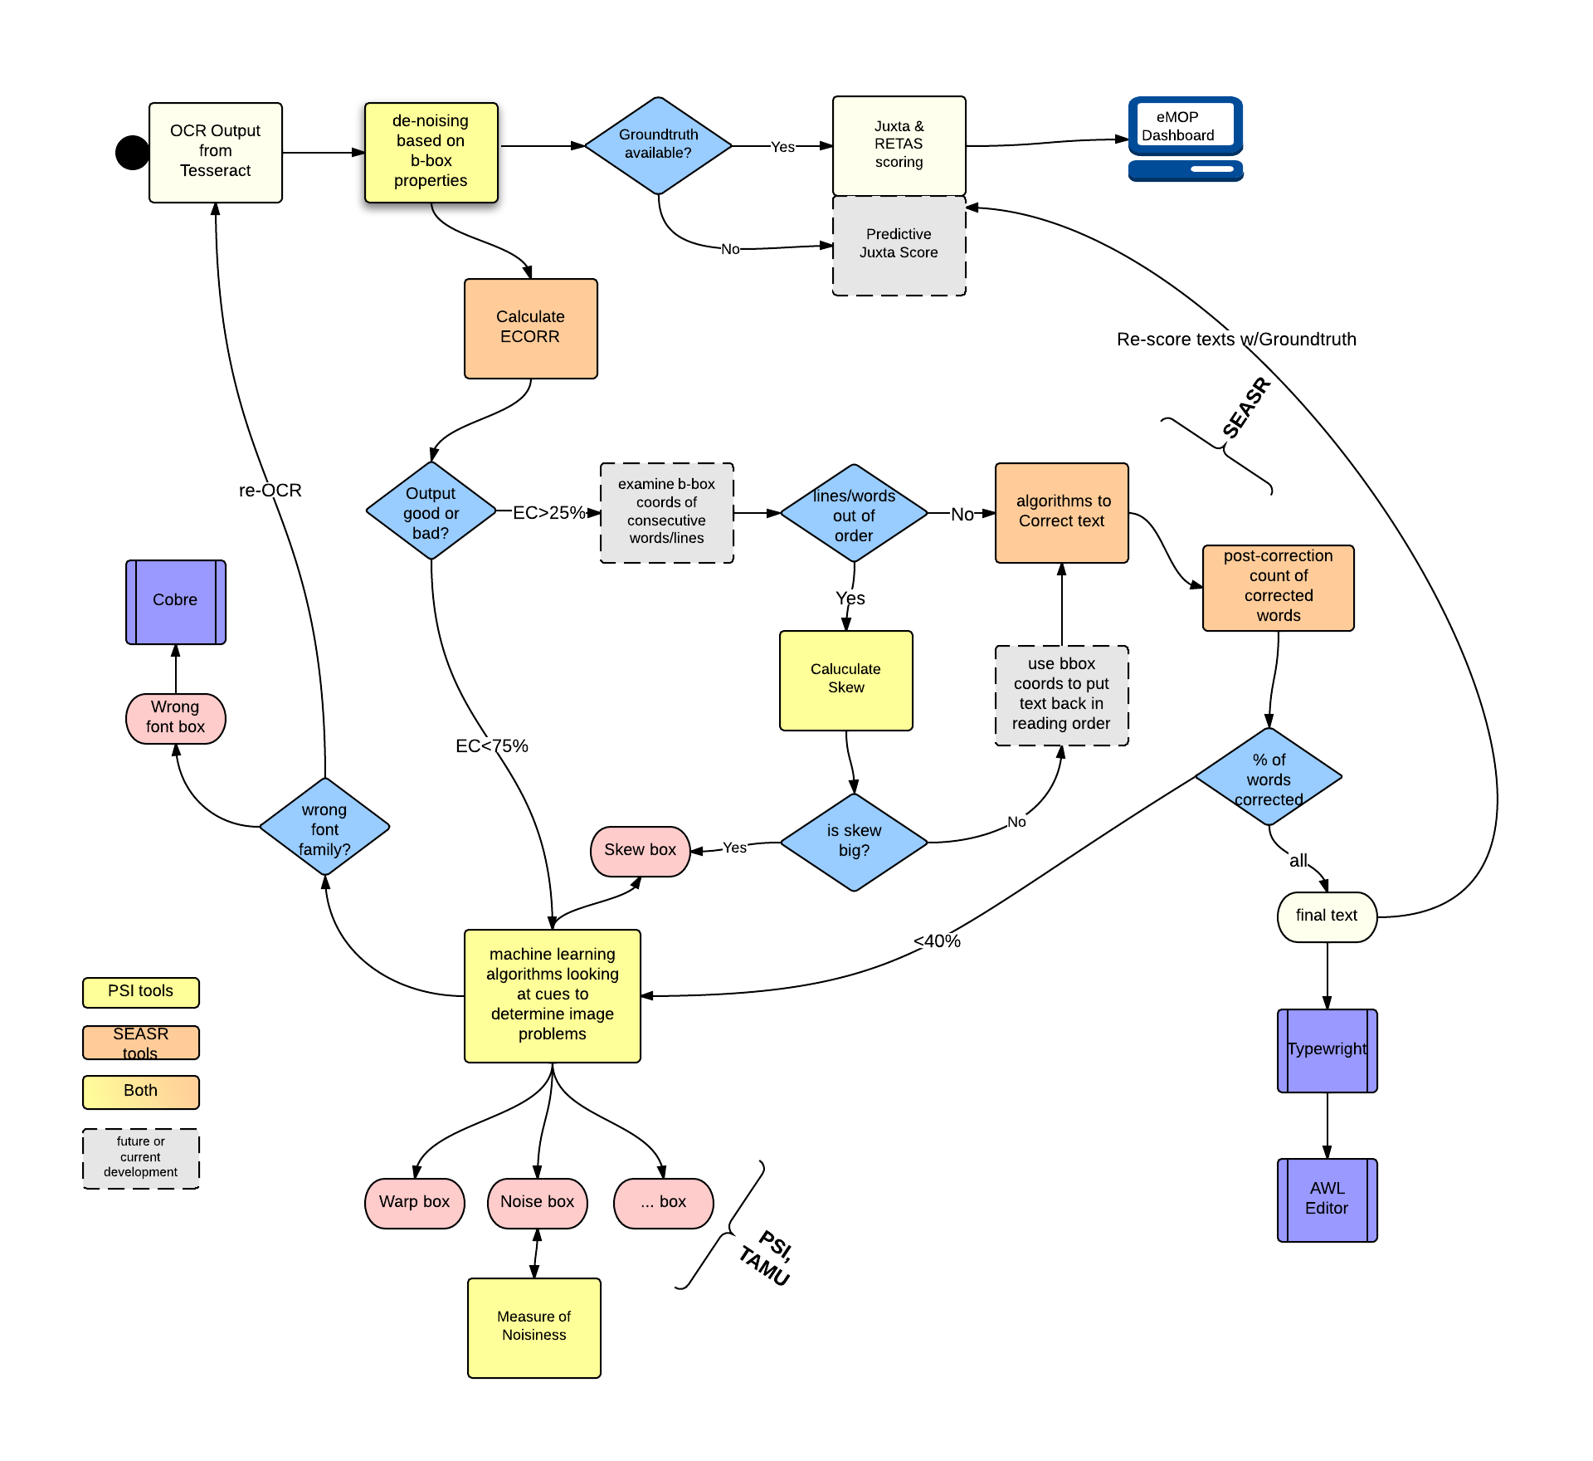
Post-Processing Triage

Slide 7

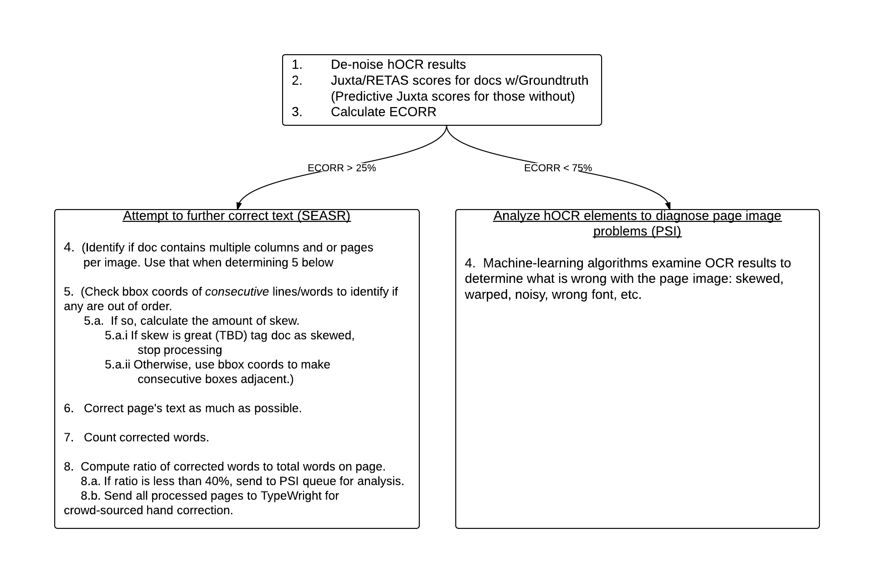
Post-Processing
Triage
Treatment
Diagnosis

Slide 8
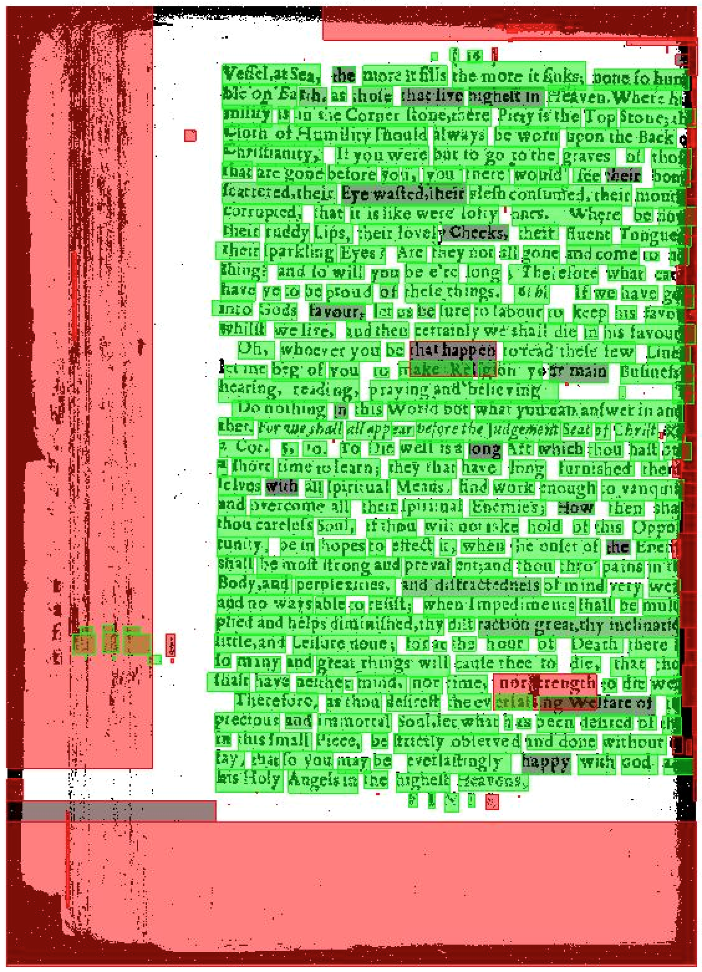
Triage: De-noising
Uses hOCR results
Determine average word bounding box size
Weed out boxes are that too big or too small
But keep small boxes that have neighbors that are “words”

Slide 9
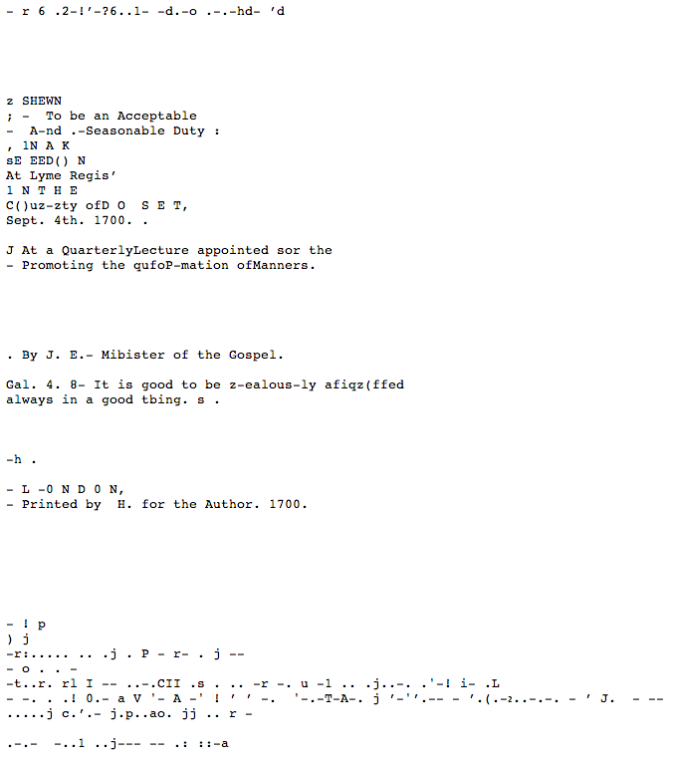
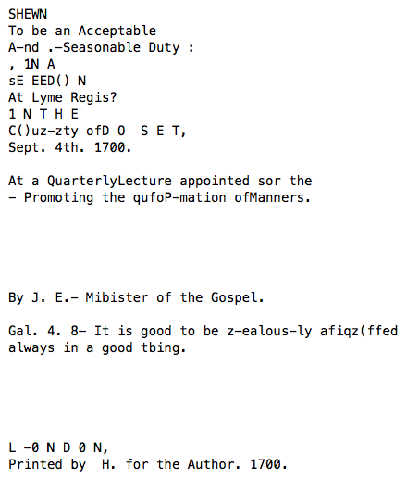
Triage: De-noising
Before: 35%
After: 58%

Slide 10
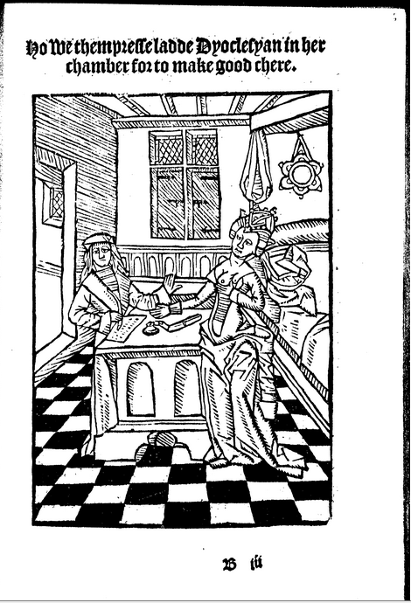
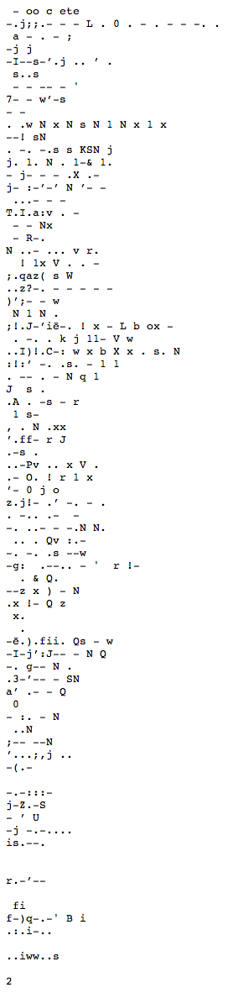
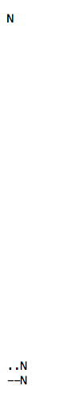
Triage: De-noising
Before
After
Notes:
Before: 55%
After: 73%

Slide 11
Triage: Estimated Correctability
Page Evaluation
Determine how correctable a page’s OCR results are by examining the text.
The score is based on the ratio of words that fit the correctable profile to the total number of words
Correctable Profile
Clean tokens:
remove leading and trailing punctuation
remaining token must have at least 3 letters
Spell check tokens >1 character
Check token profile :
contain at most 2 non-alpha characters, and
at least 1 alpha character,
have a length of at least 3,
and do not contain 4 or more repeated characters in a run
Also consider length of tokens compared to average for the page

Slide 12
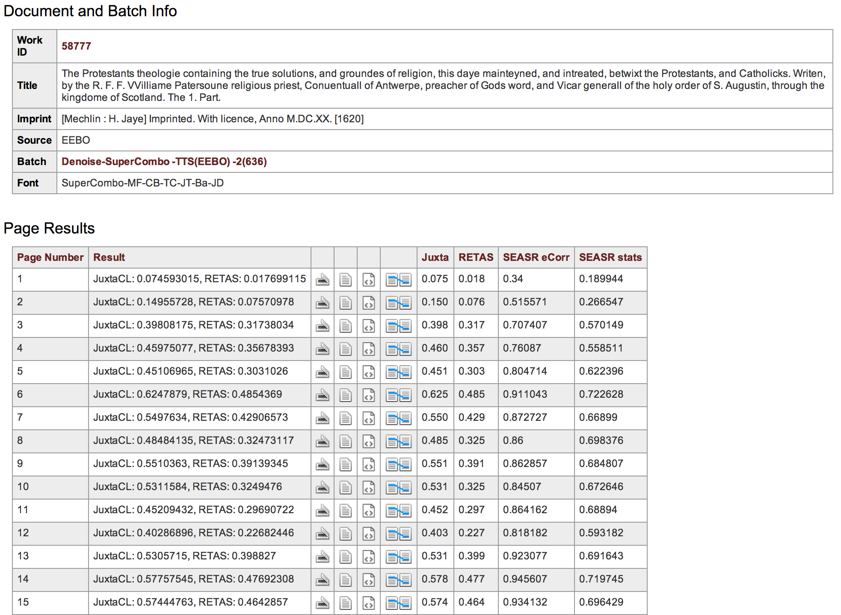
Triage: Estimated Correctability

Slide 13
Treatment: Page Correction
Preliminary cleanup
remove punctuation from begin/end of tokens
remove empty lines and empty tokens
combine hyphenated tokens that appear at the end of a line
retain cleaned & original tokens as “suggestions”
Apply common transformations and period specific dictionary lookups to gather suggestions for words.
transformation rules: rn->m; c->e; 1->l; e

Slide 14
Treatment: Page Correction
Use context checking on a sliding window of 3 words, and their suggested changes, to find the best context matches in our(sanitized, period-specific) Google 3-gram dataset
if no context is found and only one additional suggestion was made from transformation or dictionary, then replace with this suggestion
if no context and “clean” token from above is in the dictionary, replace with this token

Slide 15
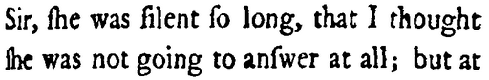
Treatment: Page Correction
tbat I thoughc Ihe Was
window: tbat l thoughc
Candidates used for context matching:
tbat -> Set(thai, thar, bat, twat, tibet, ébat, ibat, tobit, that, tat, tba, ilial, abat, tbat, teat)
l -> Set(l)
thoughc -> Set(thoughc, thought, though)
ContextMatch: that l thought (matchCount: 1844 , volCount: 1474)
window: l thoughc Ihe
Candidates used for context matching:
l -> Set(l)
thoughc -> Set(thoughc, thought, though)
Ihe -> Set(che, sho, enc, ile, iee, plie, ihe, ire, ike, she, ife, ide, ibo, i.e, ene, ice, inc, tho, ime, ite, ive, the)
ContextMatch: l though the (matchCount: 497 , volCount: 486)
ContextMatch: l thought she (matchCount: 1538 , volCount: 997)
ContextMatch: l thought the (matchCount: 2496 , volCount: 1905)

Slide 16
Treatment: Page Correction
window: thoughc Ihe Was
Candidates used for context matching:
thoughc -> Set(thoughc, thought, though)
Ihe -> Set(che, sho, enc, ile, iee, plie, ihe, ire, ike, she, ife, ide, ibo, i.e, ene, ice, inc, tho, ime, ite, ive, the)
Was -> Set(Was)
ContextMatch: though ice was (matchCount: 121 , volCount: 120)
ContextMatch: though ike was (matchCount: 65 , volCount: 59)
ContextMatch: though she was (matchCount: 556,763 , volCount: 364,965)
ContextMatch: though the was (matchCount: 197 , volCount: 196)
ContextMatch: thought ice was (matchCount: 45 , volCount: 45)
ContextMatch: thought ike was (matchCount: 112 , volCount: 108)
ContextMatch: thought she was (matchCount: 549,531 , volCount: 325,822)
ContextMatch: thought the was (matchCount: 91 , volCount: 91)
that I thought she was

Slide 17
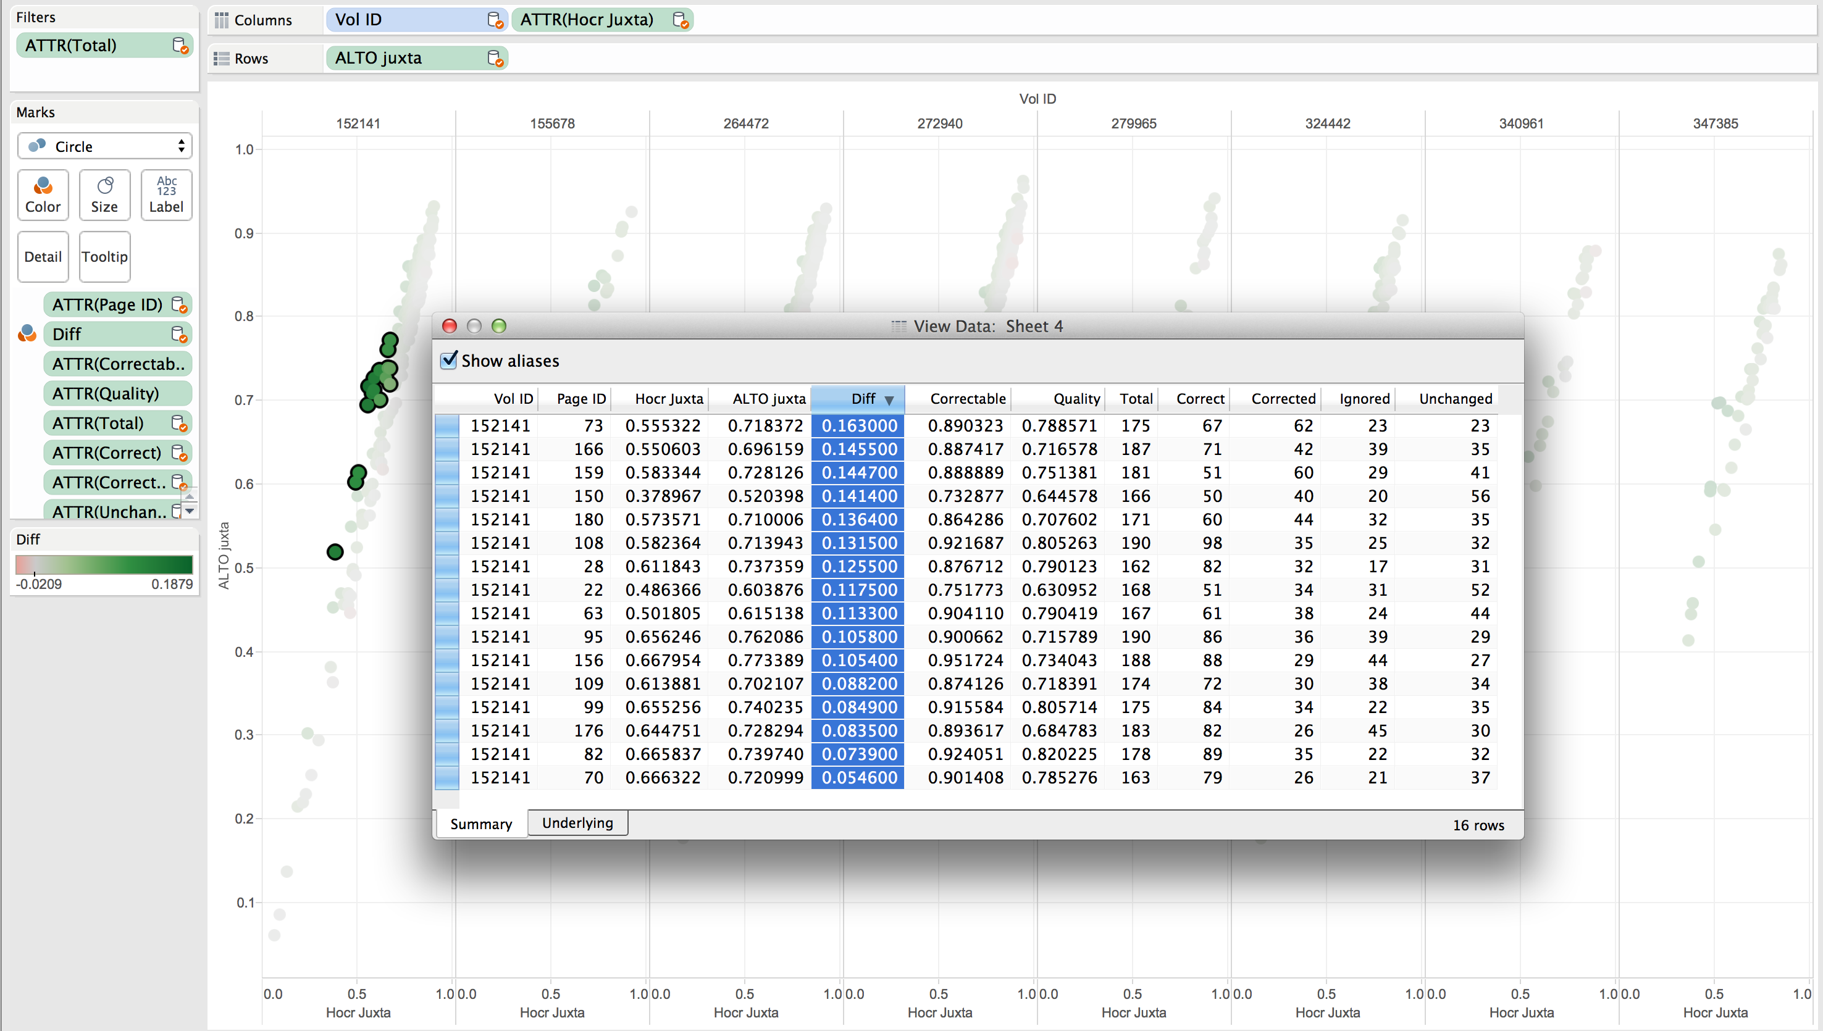
Treatment: Results

Slide 18
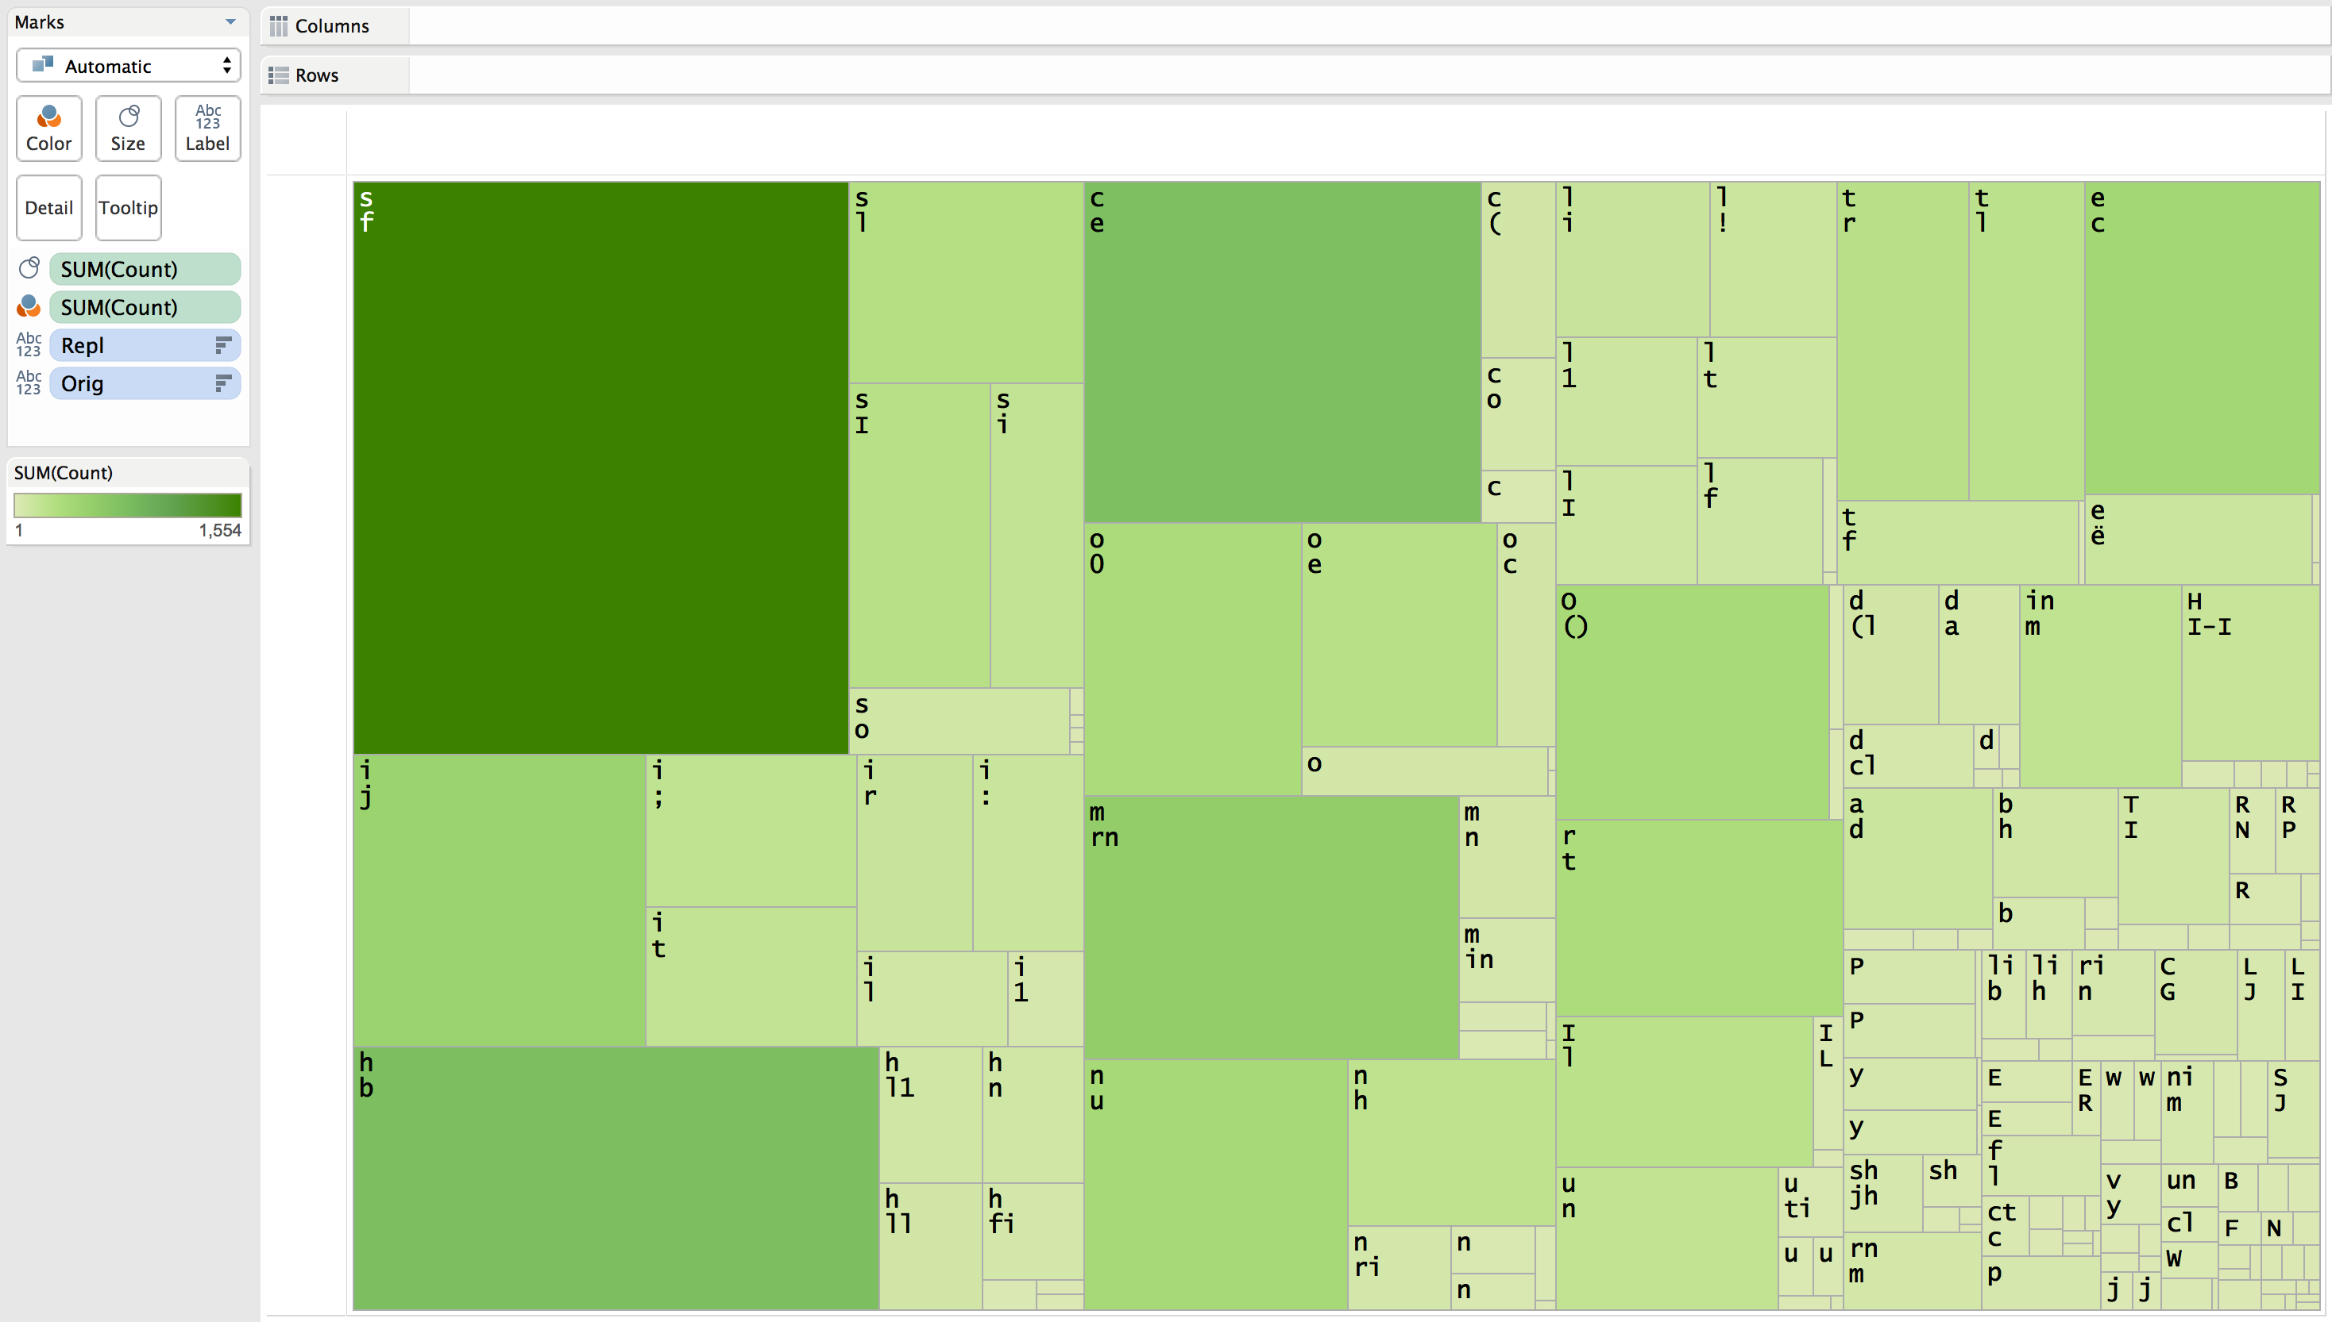
Treatment: Results

Slide 19
Diagnosis: Page Tagging
Users tag sample pages in a desktop version of Picasa
Machine learning algorithms use those tags to learn how to recognize skew, warp, noise, etc.
Have developed algorithms to:
measure skew
measure noise
Tags pages with problems that prevent good OCR results
Can be used to apply appropriate pre-processing and re-OCRing
Eventually, will end up with a list of pages that simply need to be re-digitized
This will be the first time any comprehensive analysis has been done on these page images.
Notes:
This will be the first time that any sort of comprehensive analysis has been done on the page images of these collections.

Slide 20
Further/Current Work
Identifying multiple pages/columns in an image
Predicting juxta scores for documents without corresponding groundtruth
Identifying warp
Identify and fixing incorrect word order in hOCR output
can occur on pages with skew, vertical lines, decorative drop-caps, etc.
will affect scoring and context-based corrections
Develop measure of noisiness
Develop measure of skew-ness

Slide 21
The end
For eMOP questions please contact us at :
mchristy@tamu.edu
egrumbac@tamu.edu

